Slide 1
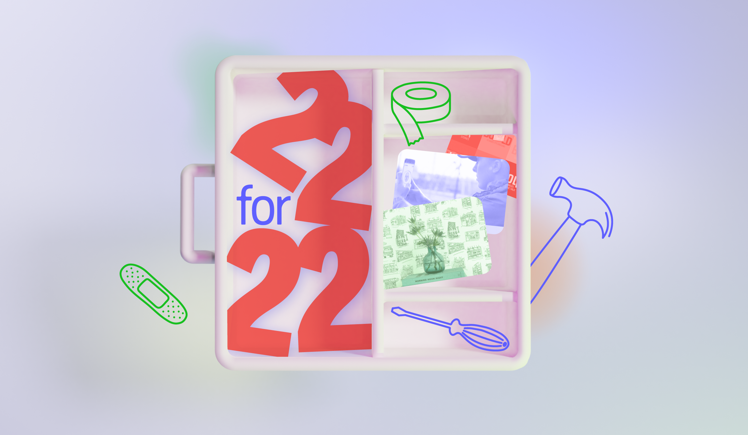
Notes:
Welcome to the slide deck of the 22 for ‘22 webinar that we hosted on January 25th. If you happen to have mised it, please consider rewatching the webinar on YouTube to get the full experience as our Senior Trend Analyst Erick Smet guides you through the selected mega-trends and business opportunities that are highlighted in this deck.
Consider this your purpose-driven manual for the year ahead — a collection of 22 business opportunities and emerging consumer trends that your brand can't afford to miss. A future forward toolbox if you will. For the full publication, please use the link below.
Link webinar: https://www.youtube.com/watch?v=4Cd3IMXZGQk&ab_channel=TrendWatching
Link publication: https://www.trendwatching.com/22-trends-for-2022

Slide 2
Let’s reflect on the past year for just a second.

Slide 3

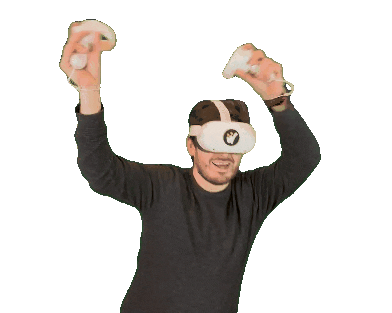

Slide 4
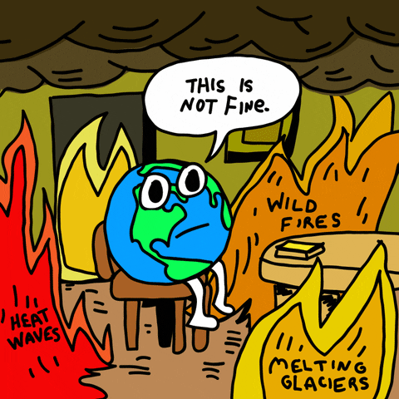
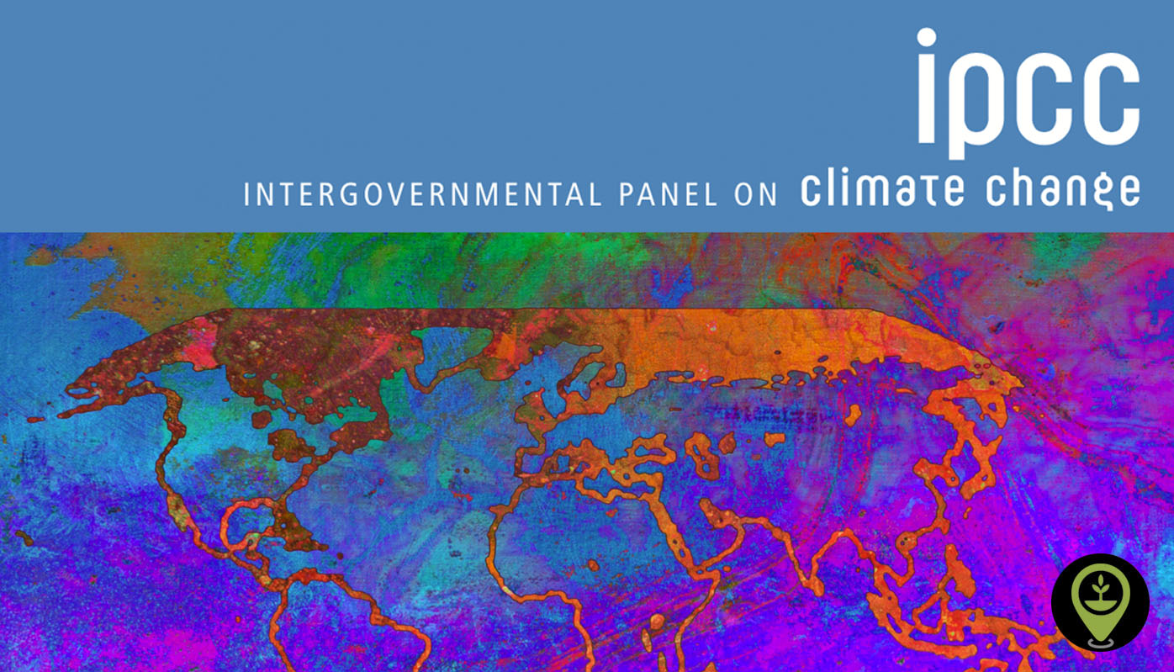

Slide 5




Slide 6


Slide 7
It’s not all bad though.

Slide 8

Notes:
Vaccines are still being deployed globally. And at the same time, vaccine research has led to multiple breakthroughs in the search for an HIV remedy and cure.

Slide 9
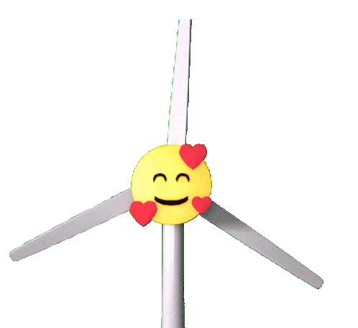
Notes:
In January a report revealed that, for the first time, renewables generated more electricity than fossil fuels in Europe for the whole of 2020 – a sign of how quickly wind and solar are scaling up.

Slide 10
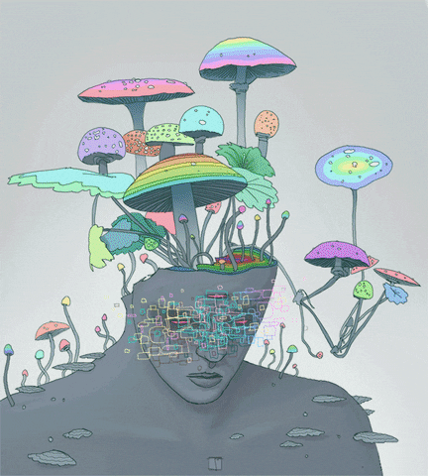
Notes:
Researchers examining whether psychedelics can treat depression and other mental health conditions continued to break new ground in 2021. In March, a potent hallucinogen used in shamanic rituals – DMT – was mooted as a potential cure for depression. A trial launched to find out more. Other clinical trials showed promise, including one that used talking therapy and psilocybin – the psychoactive ingredient found in magic mushrooms – to treat depression. It concluded in November and was found to have reduced depressive symptoms in participants. More research is needed, but early data looks encouraging.

Slide 11
Apocaloptimism anyone?
Notes:
Even though we can’t predict when or if the pandemic will end, or when the next climate disaster will hit us, we can provide you with actionable insights and meaningful business opportunities that have arisen amidst all of this change, good or bad.
Because even though it can sometimes appear as if the apocalypse is here, we prefer to practise apolocaloptimism instead. Try saying that 10 times in a row.

Slide 12

Notes:
I.e. we know it’s all going to sh*t, but at the same time we also believe things will be ok if we start acting now. So that is why ACTION is the name of the game for this webinar.

Slide 13
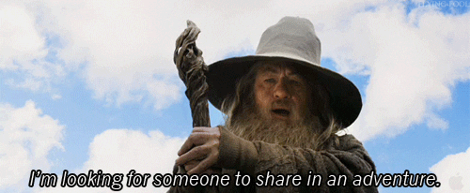
Notes:
Are you ready?

Slide 14
By the end of this webinar you will know how to help consumers cope, connect, simplify, localize and immerse.
Notes:
Usually I would provide you with a trend overview from the start, but I decided I wanted to be a tease today and keep you guessing! Guessing is part of this webinar too, because I would really like for you to be part of this trend adventure together with us. This means that I’ve sprinkled a couple of polls throughout this presentation to check if you’re actually paying attention, but also to gauge how the opinion of this creative bunch compares to the global average.

Slide 15
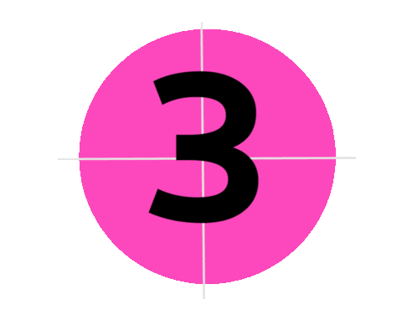
Notes:
Notebooks ready?

Slide 16

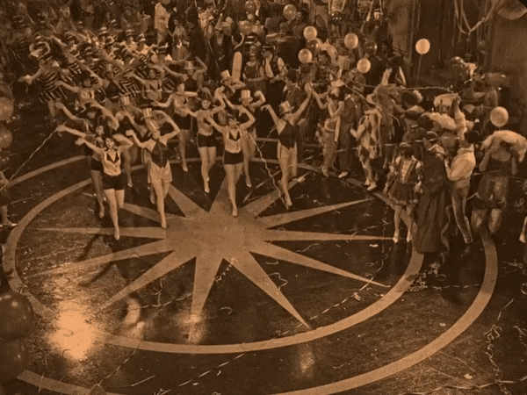
Roaring twenties?
Notes:
Although the 1920s are often glamorized, the fun-loving ‘jazz age’ was belied by economic depression and growing political extremism. The world has evolved significantly since then, but there’s an obvious synchronicity between that era and today. Economic depression? Check. Growing political extremism? Check. A pandemic to top it all of? Triple check.

Slide 17
77% of consumers worldwide expect brands to show support to people in times of crisis.
Havas,
2021

Slide 18
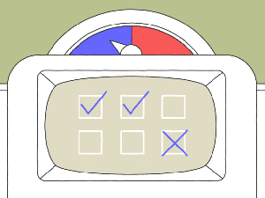
Notes:
Just to test if you are paying attention. Let’s start off with an easy poll. You put on the hat of trend researcher for a second, and tell me what this trend is going to focus on:
This trend centers the topic of:
On mental health
Countering boredom
Historical parralels
Fun

Slide 19


FREEDONISM
Fun as the ultimate fear antidote
Notes:
Pre-pandemic, consumers faced daily challenges – climate change, rising income inequality, threats of terrorism, and more. But COVID-19 was one threat too many, and global anxiety ensued as a result. One powerful remedy to combat the feeling of languishing? FUN! Help consumers unlock hedonistic tendencies and trade a state of worry with a state of freedom.
Link: https://www.trendwatching.com/22-trends-for-2022#freedonism

Slide 20
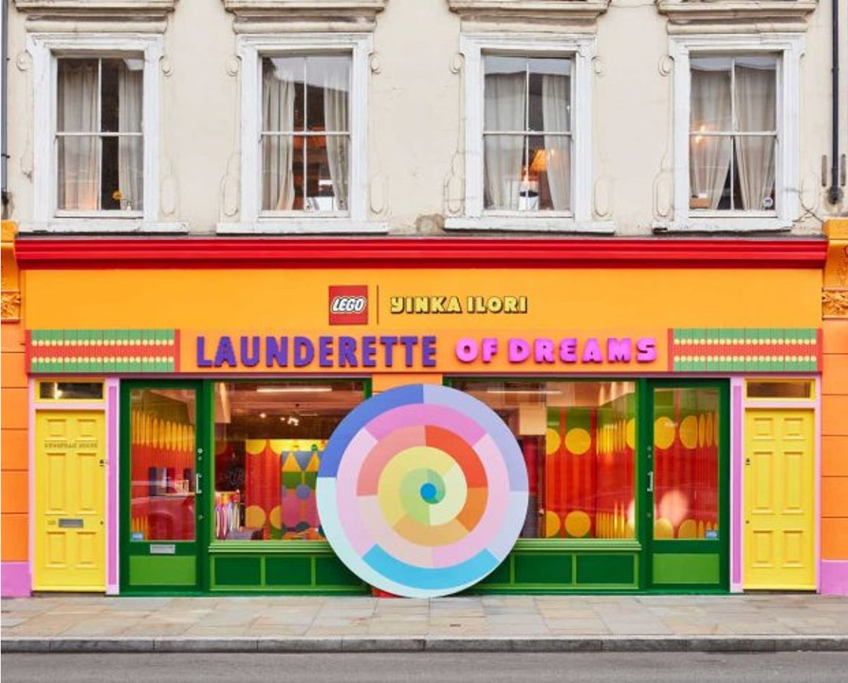
YOUTH GOGGLES
LEGO
Designer and toymaker team up on colorful laundromat inspired playzone
Notes:
Demonstrating that even the most mundane spots can foster a sense of fun, LEGO recently built the Launderette of Dreams in East London. Free to enter, the vibrant, interactive play space was designed by artist Yinka Ilori, using over 200,000 LEGO bricks. Vending machines dispensed toys instead of soap, and visitors were invited to (re)build a giant mural wall.
Consumers are in flux: they’re questioning the ‘old normal’ and trying to figure out what’s next. Pure frivolity is a serious part of that process – helping people not only to loosen up, but to see the world afresh.
Link: https://www.trendwatching.com/22-trends-for-2022#youth-goggles

Slide 21
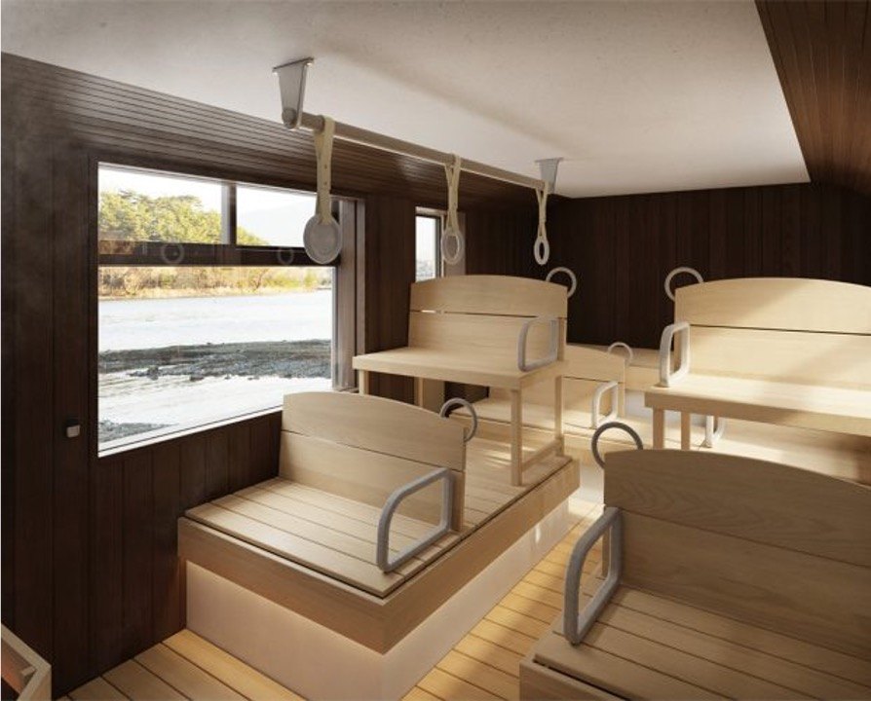
PLAYFUL PIVOTS
SHINKI BUS CO. LTD
Disused city buses converted into mobile saunas ​
Notes:
With public transport falling out of favor in pandemic-era Japan, Shinki Bus Co., Ltd is rethinking its vehicles as mobile real estate. Its first innovation? A bus converted into a wood-fired sauna: the Sabus, with traditional wooden sauna benches and bus features like hanging straps and stop buttons, now pressed to add steam. Sabus is scheduled to start service in February 2022.
Forget hand sanitizer, tomorrow’s consumers need brands to help them blow off steam, literally. Pivot to provide relief and relaxation — for the masses, not just the top 10%! — and your brand may well earn widespread respect.
Link: https://www.trendwatching.com/22-trends-for-2022#playful-pivots

Slide 22
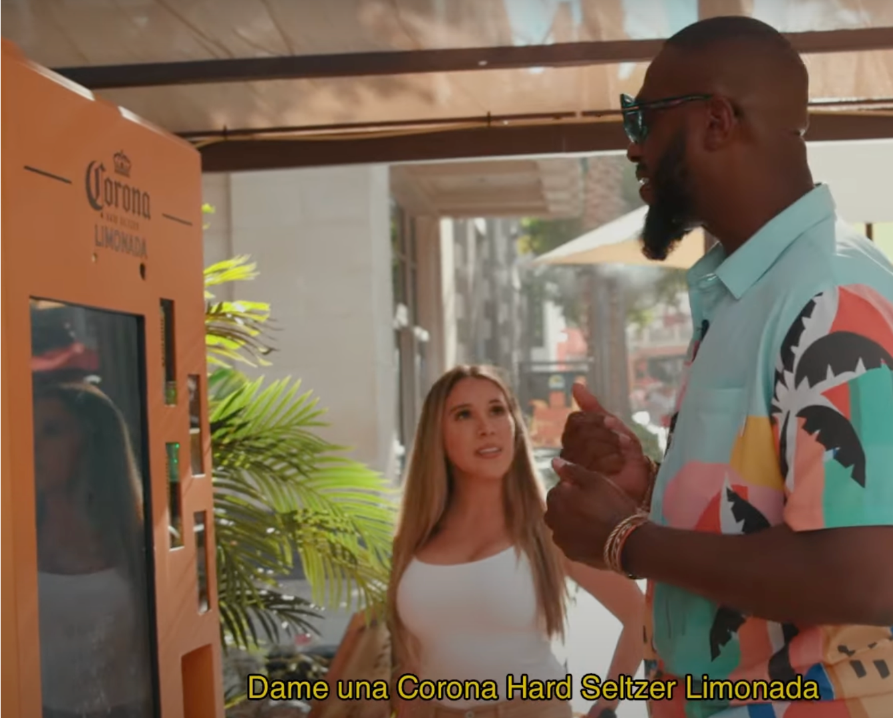
THRILLS & SKILLS
CORONA & DUOLINGO
Voice-activated vending machine challenges customers to order drinks in Spanish
Notes:
To launch its new Hard Seltzer Limonada line, Corona partnered with language-learning app Duolingo for a voice-activated vending machine that asked people to order in Spanish: “Dame una Corona Hard Seltzer Limonada, por favor.” Those with correct pronunciation were rewarded with a can of Limonada, while those in need of practice were offered a free one-month subscription to Duolingo Plus.
People are bursting into the post-pandemic era with a new appetite for fun. But play doesn’t need to be mindless. Consumers will relish brands that provide novelty and encourage personal growth.
Link: https://www.trendwatching.com/22-trends-for-2022#thrills-skills

Slide 23
Your strategy to help consumer cope:
Youth goggles
Playful pivots
Thrills & skills
Notes:
YOUTH GOGGLES
Most kids (85%) claim to have fun ideas for how they would change the world for the better, while 58% enjoy coming up with ideas to make the world less boring. Invite them into the boardroom to help create initiatives which give people permission to play.
PLAYFUL PIVOTS
Before transforming your office into a sauna, identify which parts of your business would benefit from a playful pivot. Could you recycle underutilized resources to provide unmitigated relaxation — an offering tomorrow’s consumers actually crave?
THRILLS & SKILLS
Corona × Duolingo works for two reasons: it provides an element of surprise and reminds consumers of their potential to learn. Can you catch people’s attention with a cross-industry collaboration that provides unexpected thrills and esteem-boosting new skills?

Slide 24
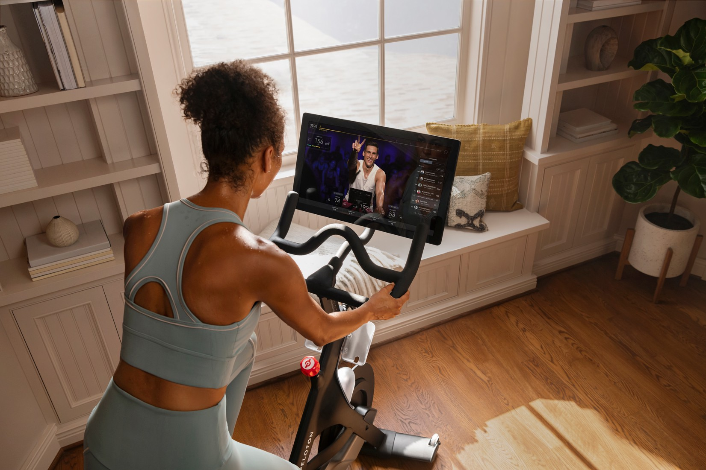
What do Peloton…

Slide 25
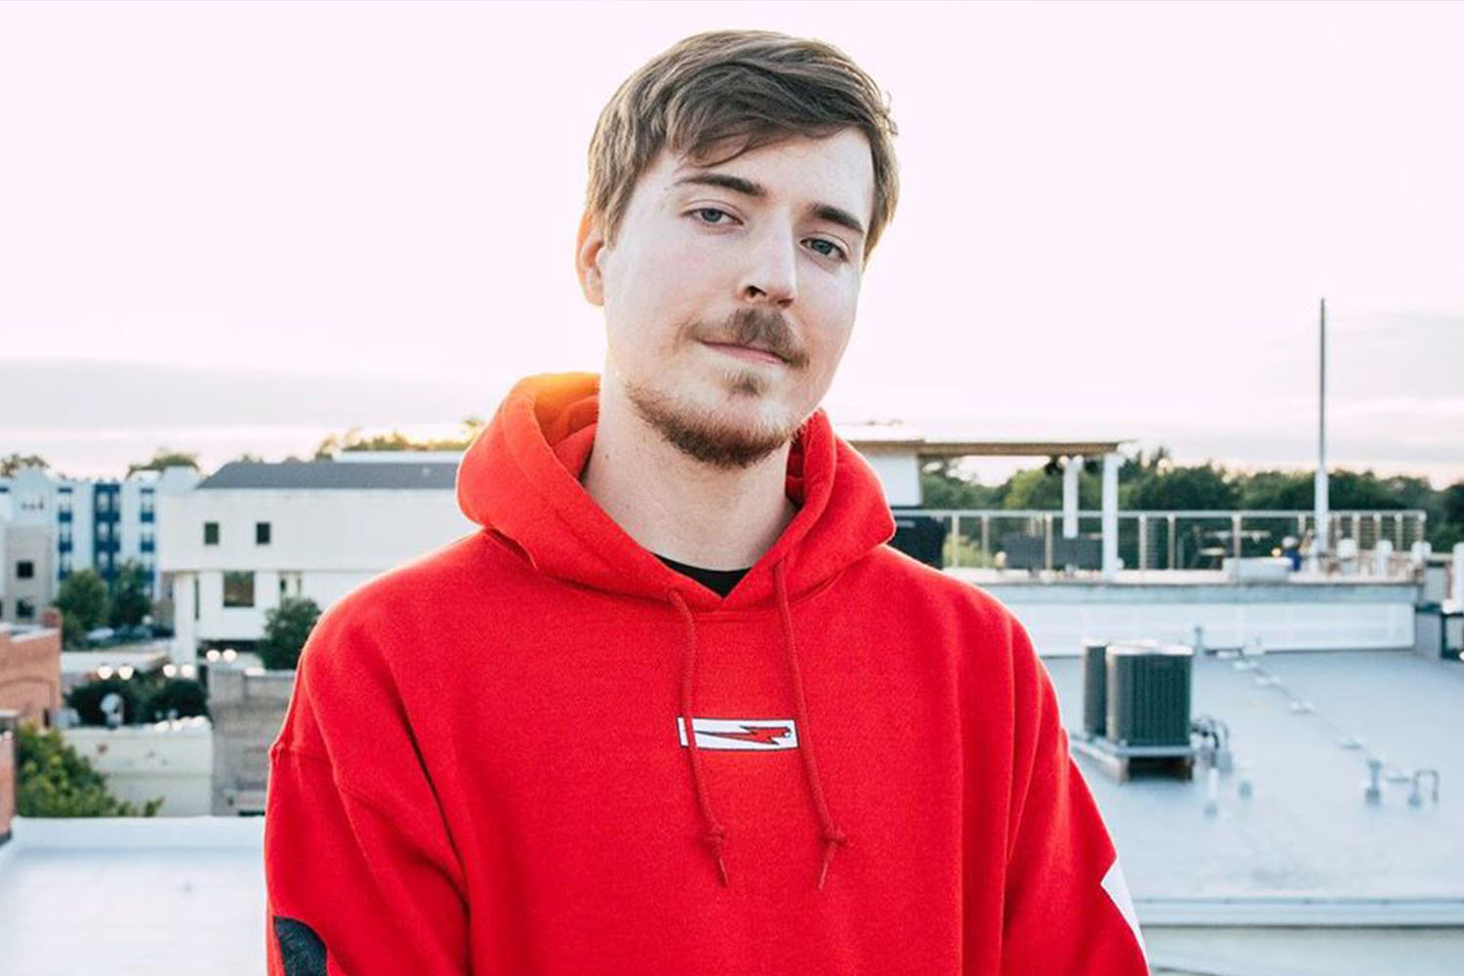
Mr. Beast...

Slide 26

…and Fridays for Future have in common?
Notes:
You might say ‘probably not much’, which would be correct. But what they do have in common, is that each of them has managed to build a strong…

Slide 27
Community!
Notes:
…brand community surrounding their offering. But why are products, services and creators that focus on creating a community so successful? Well, one reason is that…

Slide 28
33% of adults globally feel lonely, while 41% report becoming lonelier over the past 6 months.
Ipsos,
2021
Notes:
And on top of that, Gen Z globally (those aged between 10 and 25) feel that they aren’t as close to their best friends anymore due to COVID. And this has led to the loneliness pandemic.
Even before COVID lockdowns, loneliness and social anxiety were on the rise, in part due to an increase in social media usage and a decline in offline interactions. The pandemic exacerbated our digital lifestyles and pushed traditional markers of success (a home, a family, a stable job) further out of reach. As consumers lurch into an uncertain future, forging meaningful online and IRL connections will become increasingly valuable.

Slide 29
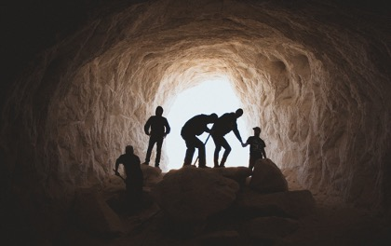
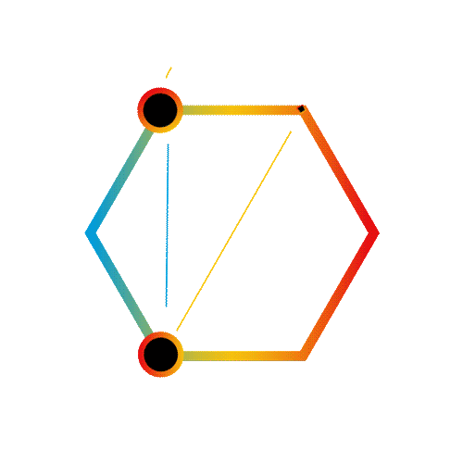
Core human need then vs. now
Notes:
Since roaming the savannas of Africa, humans have felt not just the desire but a need to cultivate social groups for survival, connection, and recognition. Today, these groups come in the form of virtual and offline communities around shared interests. And whether it’s the brand communities of Peloton, the fan community of YouTuber Mr. Beast, or activist movements like Fridays for Future, the best communities provide a safe space where people can fulfill their need for social connection and support.

Slide 30


JOYNING
Finding meaningful connections in a lonely world
Notes:
Even as endlessly evolving technologies and platforms for digital encounters continue to reshape the way we connect with each other, more and more people around the world feel lonely and isolated. Consumers are looking for brands to foster connections that are genuine, supportive, and meaningful.
Link: https://www.trendwatching.com/22-trends-for-2022#joyning

Slide 31

SOCIAL EXPRESS
DOUYIN
Helps user to connect with locally-minded people by shaking their phones
Notes:
While TikTok allows people to feel close regardless of geographical location, the app's Chinese sibling Douyin flipped the script to help users connect with those nearby. By shaking their phone, users can find others in the same city and add them to their friends list. A feature Douyin copied from rival WeChat, we should add... ;-)
Link: https://www.trendwatching.com/22-trends-for-2022#social-express

Slide 32
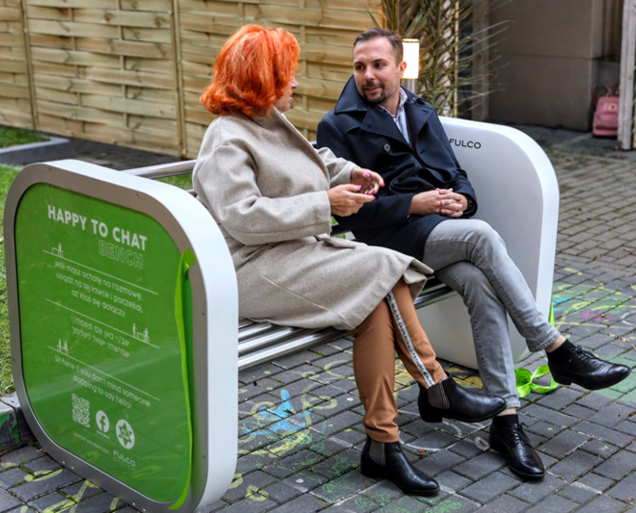
LONELI-LESS
Gaduławka
Krakow's new park benches connect strangers
Notes:
'Sit here if you don't mind someone stopping to say hello!' That's the invitation — in Polish, Hebrew and English — to connect with strangers on Krakow's new park benches, known locally as Gaduławka. Happy-to-chat benches were brought to Poland by Krzysiek Sabuda, a marketing specialist at Fulco System, which builds outdoor furniture and is sponsoring the initiative.
A third of the world’s adults reported feeling lonely in 2021, rising to 50% in some regions. With loneliness tied to depression and cognitive decline, it’s time for brands to start tackling this far more stealthy pandemic.
Link: https://www.trendwatching.com/22-trends-for-2022#loneli-less

Slide 33
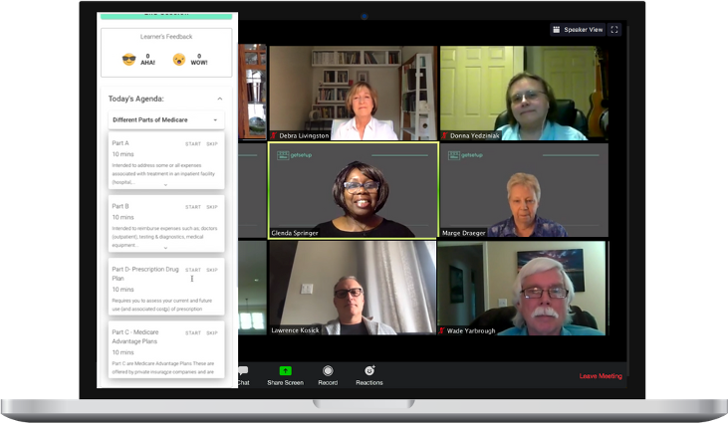
LINK 'N LEARN
GETSETUP
Encourages older adults to connect and engage through live peer-to-peer education
Notes:
Through live online classes, GetSetUp encourages older adults to connect and engage with their peers. The platform was designed to make it easy for anyone to teach or join a small class, interacting as they cook, dance or learn to play the guitar. Launched in India, GetSetUp is now used by over 4 million people in 160+ countries.
The pandemic has given rise to a new wave of (typically older) digital converts, many of whom are keen to seek out their virtual tribe. Having recognized its mental health benefits, everyone from local governments to healthcare providers has collaborated with GetSetUp.
Link: https://www.trendwatching.com/22-trends-for-2022#link-n-learn

Slide 34
Your strategy to help consumer connect:
Social Express
Loneli-less
Link ‘N Learn
Notes:
SOCIAL EXPRESS
Consumers are hungry for new experiences and connections. And that doesn’t (necessarily) mean international adventures. The more locally-minded consumers of tomorrow will want to connect with those in their immediate surroundings, albeit from the safety of a digital interface.
Disclaimer: this opportunity isn’t just for tech giants. Can you leverage your social media, app or email list to spark new, close-to-home connections?
LONELI-LESS
The most powerful antidote to loneliness is an IRL human connection – not so easy to find in today’s busy, tech-saturated world. Can you nudge people out of their lockdown bubbles and help them connect in meaningful ways?
LINK ‘N LEARN
Those consumers who’ve evaded your online engagement metrics? Now, they’re curious. Prove that the internet can be a force for good by hooking them in with interactive, peer-to-peer learning initiatives.

Slide 35
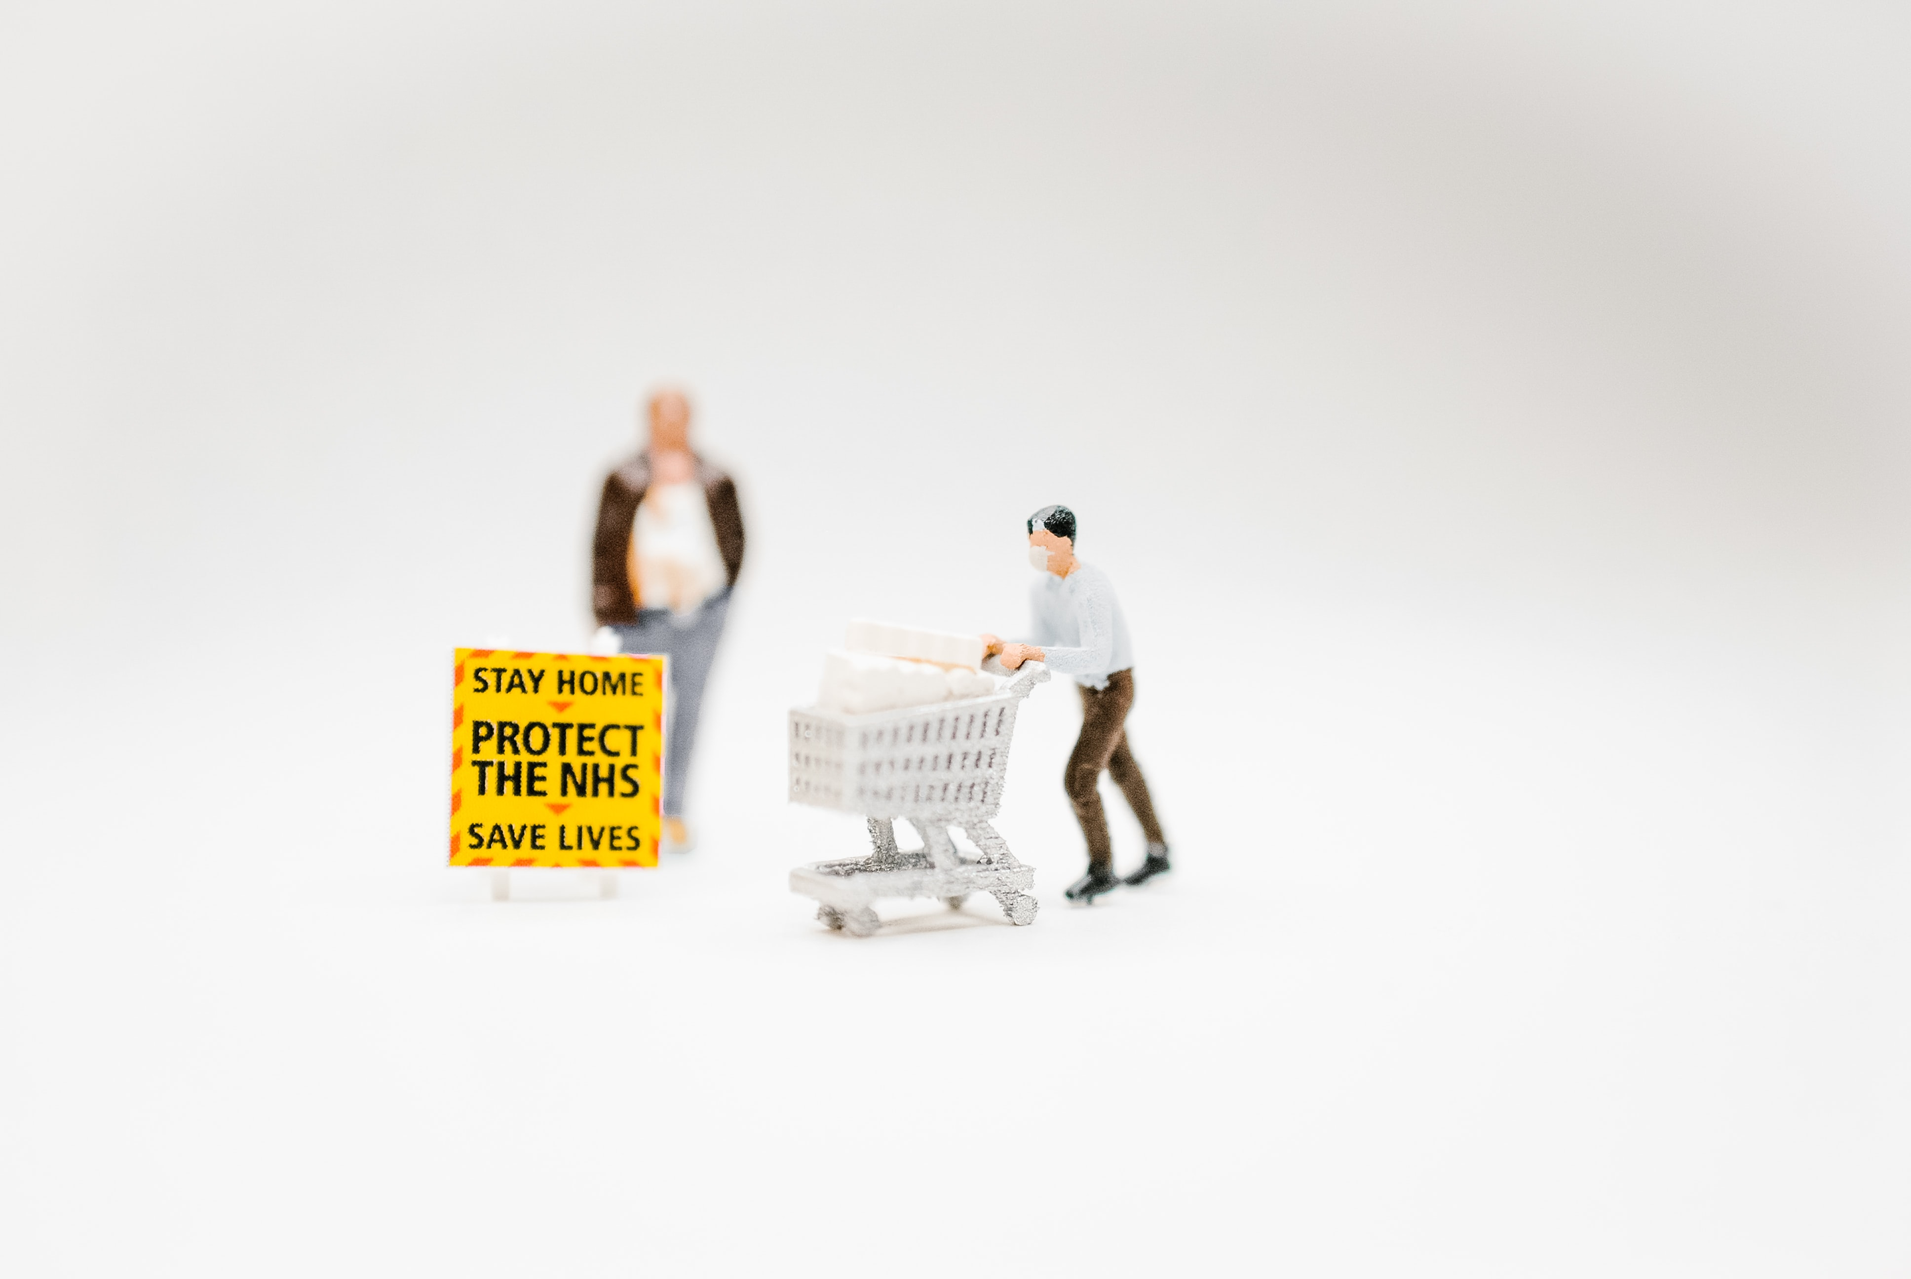
Let’s talk safety.
Notes:
So, we just established in our Joyning trend that the pandemic has heightened the need for connection, which was part of the reason why digital transformation was put into overdrive. But it obviously wasn’t the only one.
Safety fears were the key driver of e-commerce, on-demand, last-meter delivery options and more, but the convenience these new solutions offer will convert short-term change into a pandemic legacy. Take food delivery services for instance, of which the market size is expected to grow at a compound annual growth rate (CAGR) of over 10 percent, to reach $192.16 billion by 2025.
At the same time we know that consumers are keen to absolve their (social and eco) guilt, but it can be rather tricky because…

Slide 36
32% of consumers globally state lack of options as the main factor affecting their ability to shop sustainably, with 20% stating lack of time.
PWC,
2021
Notes:
many won’t want to give up on simplicity.

Slide 37
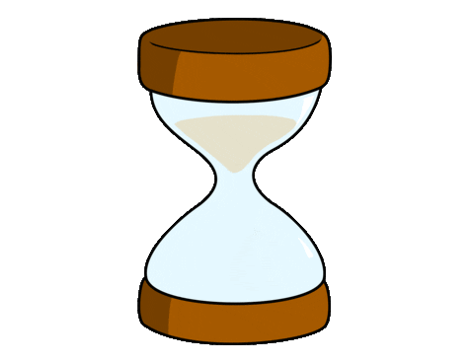
Notes:
And time is exactly what consumers do not perceive to have. Because as a result of the pandemic, the threat of climate change and global unrest, many consumers feel that time is passing by at light speed. Many are increasingly aware that a long and healthy life shouldn’t be taken for granted, and therefore these consumers will look to achieve peak productivity through time-saving products, tools and digital solutions – then fill that time with meaningful activities that enhance wellbeing and make life richer.

Slide 38
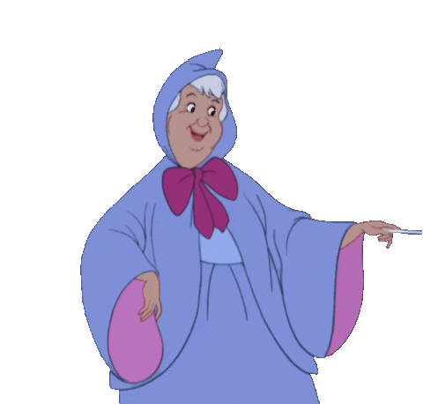
Is it magic?
Notes:
Conscious convenience, it almost sounds like magic. Well, spoiler alert, it really isn’t, but something’s gotta give. And that something or someone is you, because some innovators that have gone before you proved that conscious and convenience DO go hand in hand.

Slide 39
Notes:
Because the intention from consumers is there. Now it’s just up to you to play your part. What percentage of consumers do you think wants significant change to make the world fairer and more sustainable after COVID, whenever that may be?
61%
73%
86%
93%

Slide 40


SOLACE AS A SERVICE
The emergence of conscious convenience
Notes:
The impending purpose economy is on a collision course with demands for universal convenience. Instant anything often comes at an environmental and social cost. For many conflicted consumers, there’s a growing tension between purchase and purpose. Your call to action? Soothe their struggle and offer convenience without the culpability.
Link: https://www.trendwatching.com/22-trends-for-2022#solace-as-a-service

Slide 41

SECOND SOULS
CAMAIEU
Jeans come with ‘yoyo guarantee’ as each pair can be exchanged a larger or smaller size within a year
Notes:
French fashion brand Camaïeu’s jeans come with a ‘yoyo guarantee’. To account for waistline fluctuations, each pair can be exchanged a larger or smaller size within a year. Returned jeans are sold through Camaïeu’s Comeback program, or upcycled into new garments by nonprofit Vestali.
Post-purchase support has gone far beyond alleviating pain points. It’s now about encouraging consumers to build a long-term, sustainable relationship with the products they buy from you. Ask yourself, does your current business model put unnecessary stress on people and planet? If so, what can you do to provide conscious convenience?
Link: https://www.trendwatching.com/22-trends-for-2022#second-souls

Slide 42
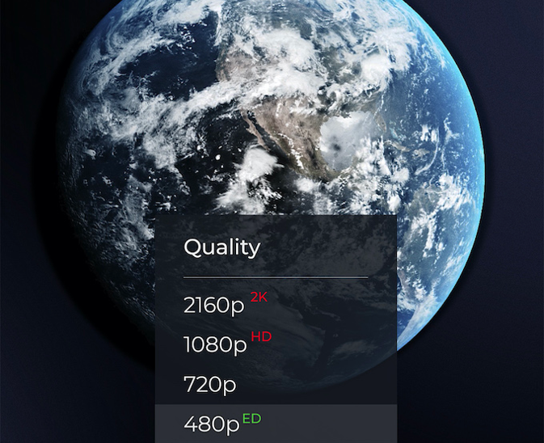
EARTH DEFINITION
EARTHDAY
Urges video platforms to add ED as an easy option for sustainable screen time
Notes:
Streaming videos in Ultra HD generates over eight times more emissions than Standard Definition. And on small phone screens, it’s overkill. Which is why EARTHDAY.ORG is calling for Standard Definition to be renamed Earth Definition and urging video platforms to add ED as an easy option for sustainable screen time.
Almost a third (32%) of consumers globally state a lack of options as the main factor for not shopping sustainably. People might want to improve their consumption habits — environmentally, socially, or otherwise — but you can’t be what you can’t see.
Link: https://www.trendwatching.com/22-trends-for-2022#earth-definition

Slide 43
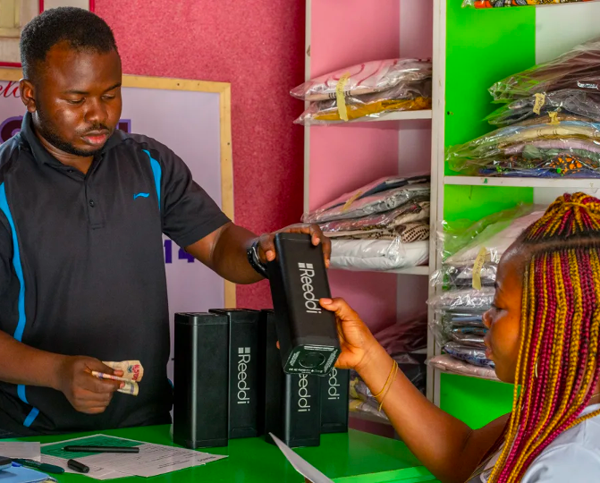
CIRCULARITY SUBSCRIBED
REEDDI
Rents out solar-powered batteries from corner stores in Lagos to provide widespread access to clean energy
Notes:
To provide widespread access to clean and reliable energy, Reeddi rents out solar-powered batteries from corner stores in Lagos. In a city prone to power outages, consumers can take Reeddi batteries home to power their lights, phones and laptops. For easy recharging, the startup plans to install solar panels on the roofs of participating stores.
Despite modern advances, access to stable electricity isn’t a given for many consumers. As climate change continues to disrupt supply (even in highly developed countries), the number of power outages around the globe is expected to increase.
Link: https://www.trendwatching.com/22-trends-for-2022#circularity-subscribed

Slide 44
Your strategy to help consumer simplify:
Second Souls
Earth Definition
Circularity Subscribed
Notes:
SECOND SOULS
While consumers have grown accustomed to everything-on-demand, many are keen to absolve their social and eco guilt. And remember: the bigger the player, the bigger the responsibility!
EARTH DEFINITION
Figure out what the ‘Earth Definition’ of your consumer offering looks like and bring it to market before someone else beats you to it. Start by confronting the least ethical parts of your CX head-on. You’ll thank us later.
CIRCULARITY SUBSCRIBED
What can you learn from communities already dealing with the effects of global warming? Can you apply those learnings to create convenient solutions that ensure consumers won’t be caught out when the going gets tough?

Slide 45

Notes:
So Solace as a Service and its opportunities mostly center around making consumers’ lives easier, while also making the world a better place. The latter can feel quite big and vast, even though the combination of ubiquitous digital connectivity, new immersive technologies and remote work have – and will continue to – bring horizons closer. But for many people, everyday life still revolves around a fixed locale, whether that’s a city, a province or a country.
Pandemic lockdowns strengthened calls to improve these localities and make them more livable, communal and healthier, building towards resilience, stewardship and accessibility.

Slide 46
51% of consumers across 22 countries agreed that they were actively doing more to support local independent businesses and buying more from local independent retailers.
PWC,
2021
Notes:
And it shows in numbers too! It’s not just because consumer want to support others, they want to support the planet too.
For conscious consumers looking to reduce their footprint, shopping local is increasingly important. But shopping local doesn’t just take care of the planet – small businesses reinvest in communities at a higher rate than chains, create local jobs, and provide products better suited to local needs. This recirculation has a positive multiplier effect that’s sustainable in more ways than one.
So consumers are engaged with local organizations and communities because they want to make a positive impact, both socially and sustainably. But there’s another main reason why consumers go local and I’m curious to see whether your opinion is aligned with the global average.

Slide 47
Notes:
Is it because of:
Fighting capitalism
It’s easier
Trust
Healthier

Slide 48
62% of people globally trust the people in their local community over CEOs and government leaders.
Edelman Trust Barometer,
2021

Slide 49


STATE OF PLACE
Consumers look to reclaim their locale
Notes:
The celebration of place often focuses on authenticity, relevance, local pride, and storytelling. And while consumers appreciate brands that help them embrace place, they’ll have particular affection for the brands that work to make those spaces better (read: more sustainable and equitable).
Link: https://www.trendwatching.com/22-trends-for-2022#state-of-place

Slide 50
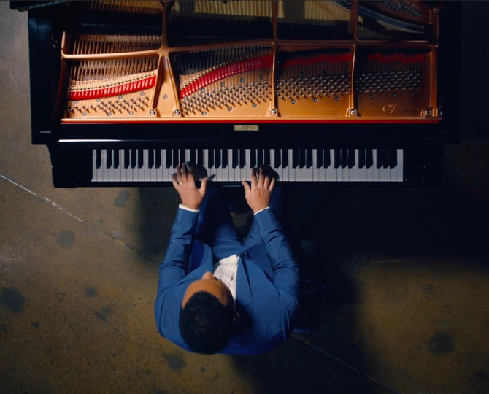
EQUITY ZONE
HUMANLEVEL
Helps community leaders in areas impacted by institutionalized racism to create long-lasting change
Notes:
National politics may get the headlines, but resources are allocated and priorities are set in school boards and on city councils. In a bid to make local government sexy, John Legend recently launched HUMANLEVEL. The organization will help community leaders in areas disproportionately impacted by institutionalized racism to create long-lasting change.
As the pandemic scoured the globe, trust in institutions, corporates and even religious leaders waned. Globally, nearly two-thirds (62%) of people trust local community leaders more than CEOs and politicians.
Link: https://www.trendwatching.com/22-trends-for-2022#equity-zone

Slide 51

GLOCALLY GROUNDED
YELP & CHASING PAPER
Produced a collection inspired by small businesses in Austin, San Francisco and New York
Notes:
Nothing says #SupportSmallBusiness like locally branded wallpaper. Yelp and the interiors brand Chasing Paper have produced a collection inspired by small businesses in Austin, San Francisco and New York – proceeds from which will go to entrepreneurship-focused nonprofits. The best part? The first 50 buyers had their wallpaper installed for free (by decorators found via Yelp, of course).
Small businesses don't have it easy in the age of one-click shopping and free shipping. But as conscious consumerism gains ground, neighborhood shops stand a fighting chance. In fact, a March 2021 survey showed 53% of people polled were more interested in shopping locally than before the pandemic.
Link: https://www.trendwatching.com/22-trends-for-2022#global-grounded-locally

Slide 52

LOCALE MORALE
ASICS & MIND
‚Uplifting Retford’ event encouraged citizens to exercise
Notes:
After surveying consumers across the UK, ASICS decided the town of Retford was due a pick-me-up. In collaboration with Mind it launched ‘Uplifting Retford’, an event to highlight the mental health benefits of exercise. Citizens exercised for 20 minutes, logging how they felt before and after on the brand’s Mind Uplifter webpage – a feedback tool which uses a combination of self-reporting and facial recognition.
Recent lockdowns strengthened calls to improve the environmental and social fabric of cities. Consumers are doing their bit. A third (32%) of global consumers claim their neighborhood banded together mid-pandemic. Can your brand make urban life better, in more ways than one?
Link: https://www.trendwatching.com/22-trends-for-2022#locale-morale

Slide 53
Your strategy to help consumer localize:
Equity Zone
Glocally Grounded
Locale Morale
Notes:
EQUITY ZONE
Bridge this trust gap with initiatives that empower local changemakers. Consumers expect brands to wade in on front-page issues, but to create measurable impact, it’s crucial to support transformation at a grassroots level. Does your brand have the resources to amplify those voices?
GLOCALLY GROUNDED
Whether your own brand spans cities or nations, can you bring together small business owners and hands-on locals? What resources can you provide to help them thrive?
LOCALE MORALE
Start with a community where your brand is already established. What are their needs? Do they align with your core values? Launch a survey before diving in…

Slide 54

Notes:
Whereas State of Place really focused on physical surroundings, this next mega-trend blurs the boundaries between IRL and URL.
COVID-19 accelerated digital transformation, with years of progress crammed into around 18 months. What was previously awkward and niche, suddenly became mind-numbingly normal: Zoom meetings, online conferences and classrooms, digital-only friends, buying groceries online, and yes… working from home (or wherever the laptop is). Although it might feel like we’re already at peak digital, as boundaries between the physical and digital blur (and become increasingly irrelevant), expect completely unforeseen possibilities to emerge.

Slide 55
The amount of money raised by companies related to the metaverse increased to USD 10.3 billion, up from USD 5.9 billion in 2020.
Crunchbase,
2021
Notes:
The amount of money raised by companies related to the metaverse almost doubled to USD10.3bn, up from USD 5.9 billion in 2020.

Slide 56
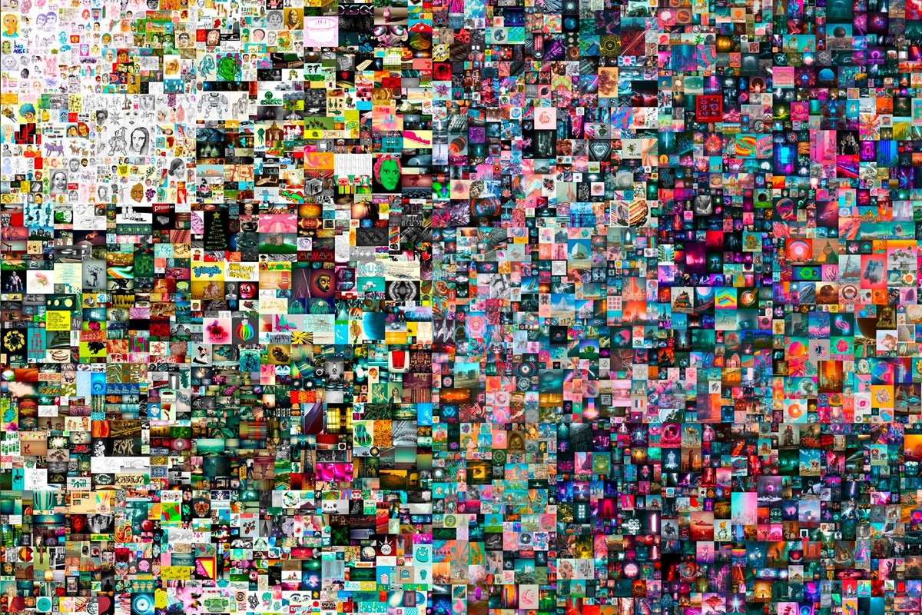
Notes:
Tech companies, entertainment and retail giants, and startups are rushing to advance and build the technologies that will enable the next evolution of the internet – through augmented and virtual reality solutions, 3D graphics, NFTs (of which this image was the top selling one of 2021), but through cryptocurrency tokens, or simply by improving internet connectivity. The promise? As all of these technologies converge, a new internet will evolve.

Slide 57
81% of global consumers think that a brand's digital presence is as important as its in-store presence.
Pew Research,
2021
Notes:
But what are consumers saying about the metaverse? In fact, 81% of global consumers think that a brand's digital presence is as important as its in-store. And many even prefer to a engage with a brand online versus in real life. But how many exactly?

Slide 58
Notes:
Percentage of consumers who prefer to interact with brands digitally:
66%
34%
71%
26%

Slide 59


METAPHYSICAL
An evolved internet
Notes:
As the physical and digital worlds continue to converge, we’re witnessing the next evolution of the internet. While yesterday’s web was dominated by websites and the social media’s infinite scroll, the next iteration will be defined by virtual worlds, metaverses, and augmented digitalphysical realities. Get ready!
Link: https://premium.trendwatching.com/megatrend/metaphysical/

Slide 60

YOU-TOPIA
THE FABRICANT STUDIO
Makes it easy for anyone to create, trade and wear digital fashion – no 3D design skills required
Notes:
New threads for the metaverse? The Fabricant Studio makes it easy for anyone to create, trade and wear digital fashion – no 3D design skills required. Users customize a master garment, mint it as a unique NFT and wear it in the 'verse. Clothing can also be sold for $FBRC, the platform's coin, with royalties split equally among all creators.
If we’ve learnt anything from the internet’s early years, it’s that power needs to be distributed (or ideally, decentralized). As consumers enter Web 3.0, they’ll look favorably upon brands that use their influence to build a more egalitarian digital world.
Link: https://www.trendwatching.com/22-trends-for-2022#you-topia

Slide 61
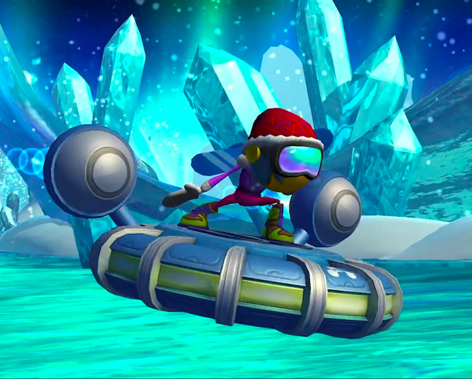
PSYCH-E
ENDEAVORRX
Video game treatment for kids with ADHD to improve attention function
Notes:
EndeavorRx is a video game treatment for kids with ADHD, created by a team of neuroscientists and game developers. Like many games, players sweep through epic virtual worlds – completing challenges as they go – but EndeavorRx has been specifically designed to improve attention function. It’s available by prescription in the US.
In recent years, the perception-altering effects of immersive technologies like VR have been used to treat everything from mild anxiety to late-stage dementia. As we meander towards the metaverse, expect these early concepts to become established healthcare solutions.
Link: https://www.trendwatching.com/22-trends-for-2022#psych-e

Slide 62
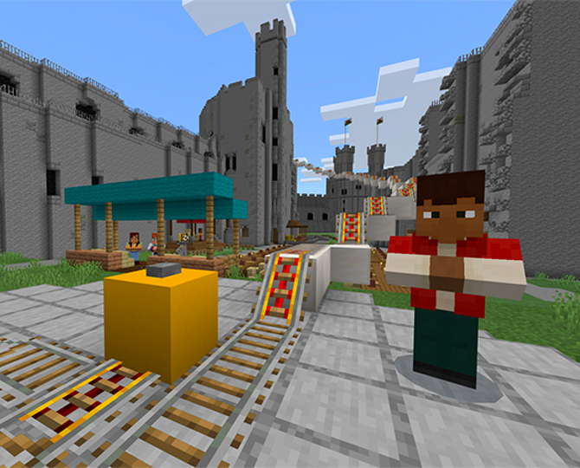
PORTALS OF POSSIBILITY
CAREER WALES
CareersCraft hosted on Minecraft is designed to help students identify their strengths
Notes:
Rethinking traditional high school career counselling, Careers Wales has launched CareersCraft — a virtual world, hosted on Minecraft, designed to help students identify their strengths. Users roam around various landmarks in Wales, completing challenges and activities along the way. At the end, they’re presented with career paths that best match their soft skills.
CareersCraft aims to get students excited about their future by lifting them out of the classroom and into an interactive environment. Can you use the metaverse to broaden consumers’ horizons – to introduce them to ideas and concepts they wouldn’t ordinarily encounter?
Link: https://www.trendwatching.com/22-trends-for-2022#portals-of-possibility

Slide 63
Your strategy to help consumer immerse:
You-topia
Psych-e
Portals of Possibility
Notes:
YOU-TOPIA
Can you empower consumers by giving them the tools and skills to build tomorrow’s metaverse? You don’t need to create an educational course of your own. Why not sponsor an existing one, like Zepeto has done at the Istituto Marangoni Miami?
PSYCH-E
As a brand, can you provide virtual tools that make it easier for people to exist in the IRL world? To create footholds in tomorrow’s metaverse, start laying the foundations now with mobile-friendly VR or AR initiatives.
PORTALS OF POSSIBILITY
The metaverse is teeming with opportunities – yes, for play, but also for personal development. As it starts to take shape, brands should ask themselves: what will our legacy look like?

Slide 64
Did someone say action?
Notes:
I did!

Slide 65
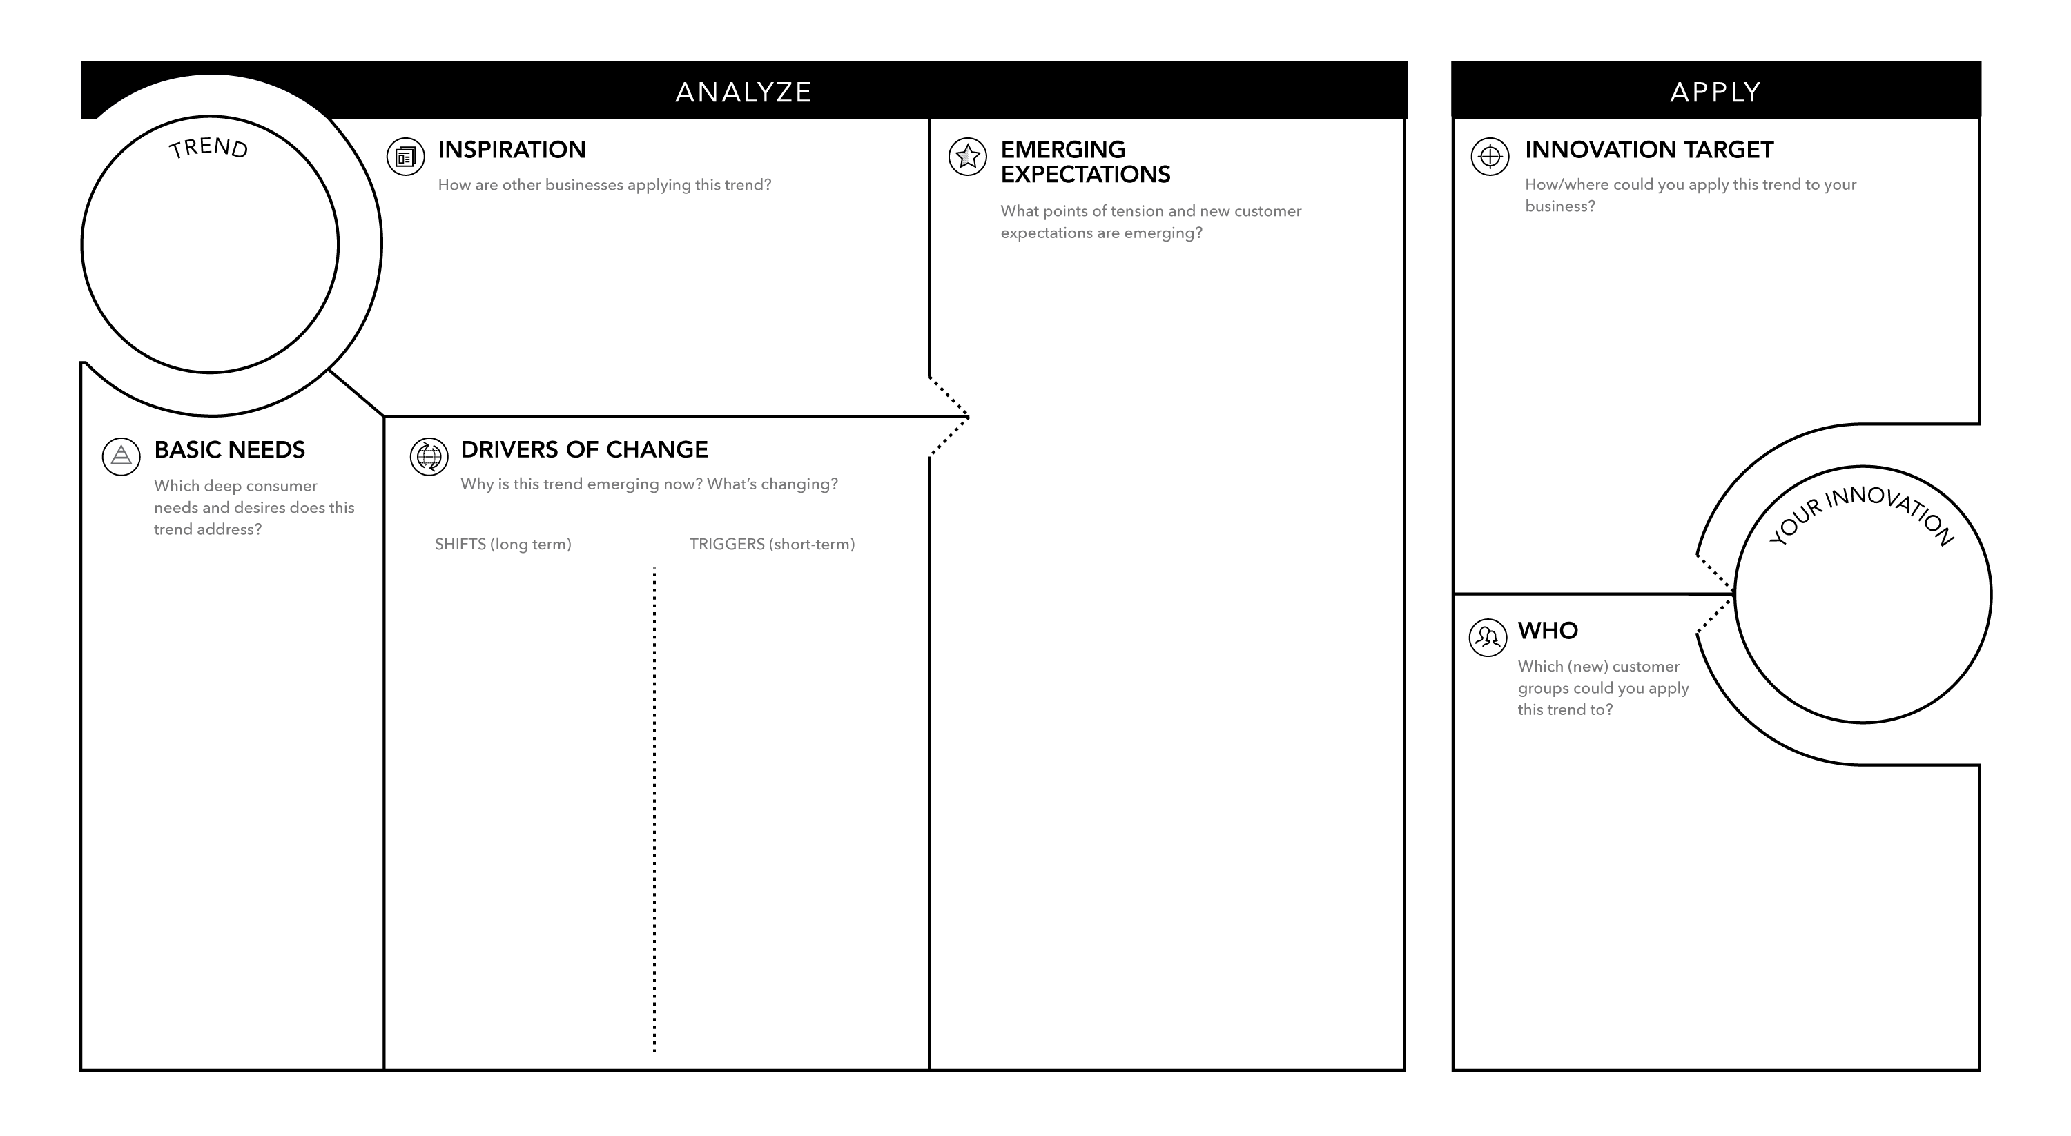
METAPHYSICAL
Notes:
Link: https://www.trendwatching.com/toolbox/consumer-trend-canvas

Slide 66
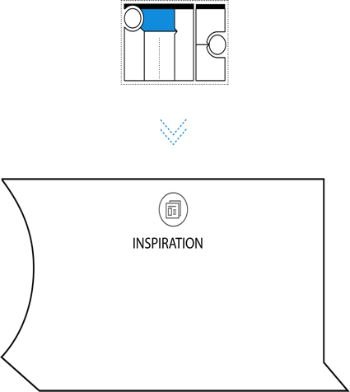

INSPIRATION
How are other businesses applying this trend?
THE FABRICANT STUDIO
CAREER WALES
ENDEAVORRX
Notes:
Start by looking for innovations – products, services, marketing campaigns or business concepts which are shaking up Business As Usual and setting new consumer expectations. If you don’t have a stable of trusty research resources, finding relevant innovations can take quite a while. We recommend browsing Fast Company, Design Boom, or Innovation of the Day (😁) to find examples of META-PHYSICAL in action.
To make things simple, we will be plucking innovations straight out of 22 for ‘22. We’ve chosen the Government of Wales’ educational online platform Career’s Craft; the virtual fashion design platform, The Fabricant Studio; and EndeavorRx.
Link: https://www.trendwatching.com/toolbox/consumer-trend-canvas

Slide 67
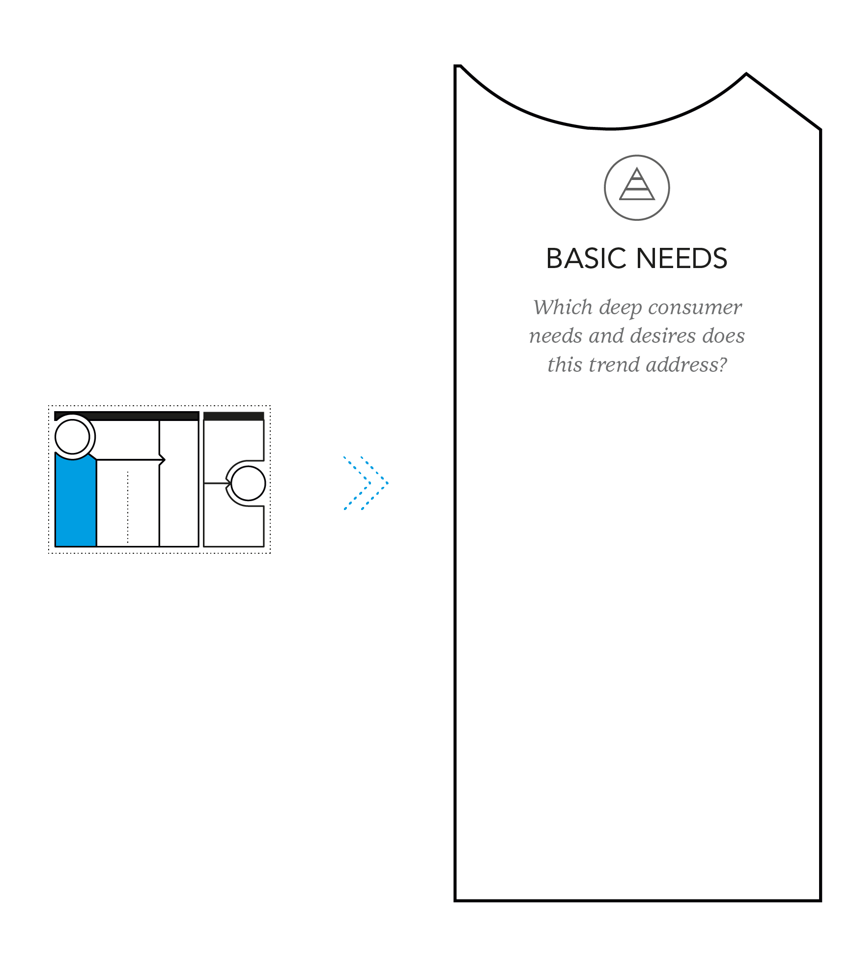
BASIC
HUMAN NEEDS
What deep consumer needs & desires does this trend address?
SELF-EXPRESSION
IDENTITY
ENTERTAINMENT
SOCIAL
STATUS
Notes:
Now, think about how your chosen mega-trend and innovations cater to basic human needs. ‘What are basic human needs?’ you ask. It can be anything from the need for human connection to the need for creative self-expression. There are no wrong answers here but choosing more than four or five might complicate the process so go light on the post-its!
For us, the need for personal identity and self-expression will be irrevocably changed by this mega-trend, as people find new, digital avenues to present themselves. We also think META-PHYSICAL taps into the timeless need for community, and that these new online communities will create new ways to build social status. And of course, perhaps the most obvious human need that META-PHYSICAL fulfils: entertainment.
Link: https://www.trendwatching.com/toolbox/consumer-trend-canvas

Slide 68
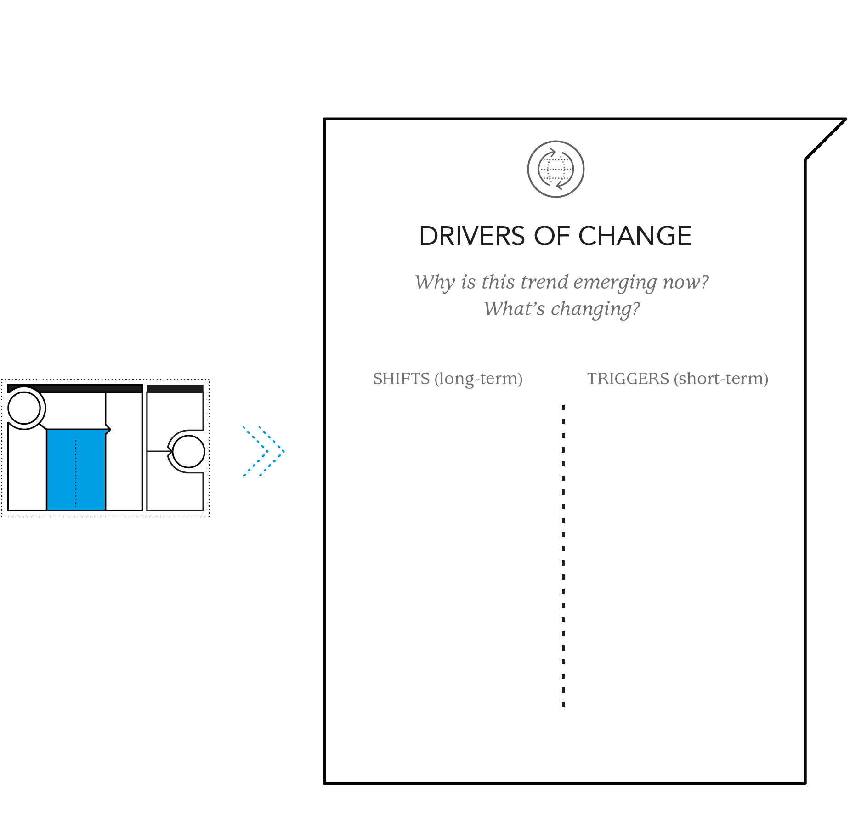
DRIVERS
OF CHANGE
Why is this happening now? What’s changing?
NEW REALITIES
META GOLDRUSH
SOCIAL MEDIA
REMOTE WORK
DECENTRALIZED INTERNET
Notes:
When we discuss Drivers of Change (DoC) they can be split into two – long-term shifts that move slowly over time, and triggers that immediately change the industry landscape and influence consumer behavior rapidly. There’s often overlap between shifts and triggers so don’t worry too much about filing them under the ‘correct’ column, so to speak.
For META-PHYSICAL, one shift could be the rise of new digital technologies such as AR, VR, and MR (new realities), social media, or the gradual movement towards more decentralized digital platforms.
As for triggers, we opted for the Meta gold rush with brands scrambling in the wake of Mark Zuckerberg’s October announcement, and the rapid shift to remote work prompted by the pandemic which has led people to engage virtually in evermore creative ways.
Link: https://www.trendwatching.com/toolbox/consumer-trend-canvas

Slide 69
SHIFTS
Notes:
Shifts are the long-term, macro changes that are playing out across years, or even decades. These are things constantly happening in the background to our everyday lives and out of our control. Like the rising middle-class, advancement of AI, omnipresence of social media in our lives and more.
Rise of Social Media, Urban Transition, Access Democratization, Expanding Middle Class, Rising of the Experience Economy, Widespread Wellness, Transparency, Post-Demographic Identities, Re-Mapped Globalization, Big Data, Social polarization, Time sensitivity, On-demand economy, AI Power, Start-up Culture, Sustainability

Slide 70
TRIGGERS
Notes:
Triggers are the more immediate changes that drive the emergence of a consumer trend.
Think of those things that happened recently that immediately changes society – either globally or locally that had a big impact on consumers. These can include specific technologies, political events, changes to legislation, shocking news stories, economic shocks, environmental incidents, and obviously... A PANDEMIC!

Slide 71
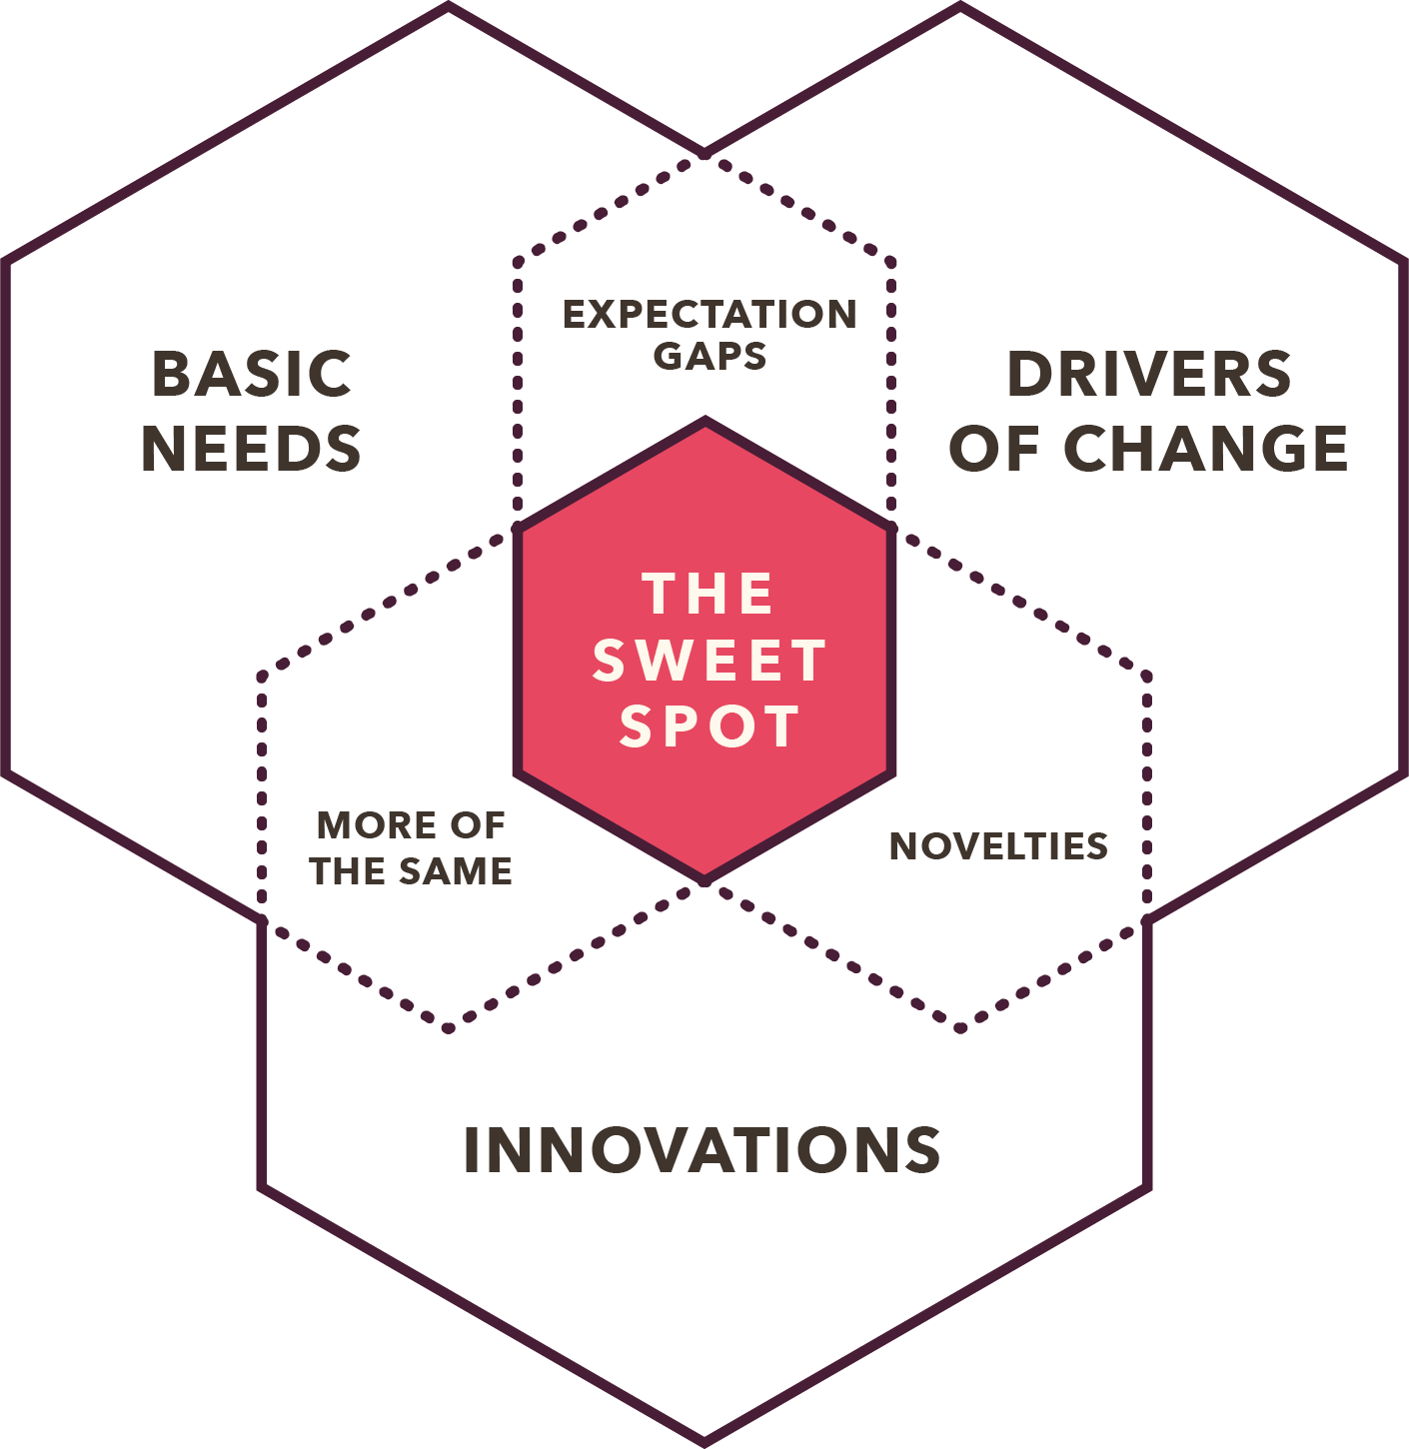
Notes:
We know already that new consumer trends emerge when basic human needs bump up against external change to unlock needs, wants and desires & to identify these newly emerging needs, wants and desires, look for expectation gaps between what consumers want, and what they currently have.
Ask yourself, What do consumers now expect from brands that they didn’t before?

Slide 72
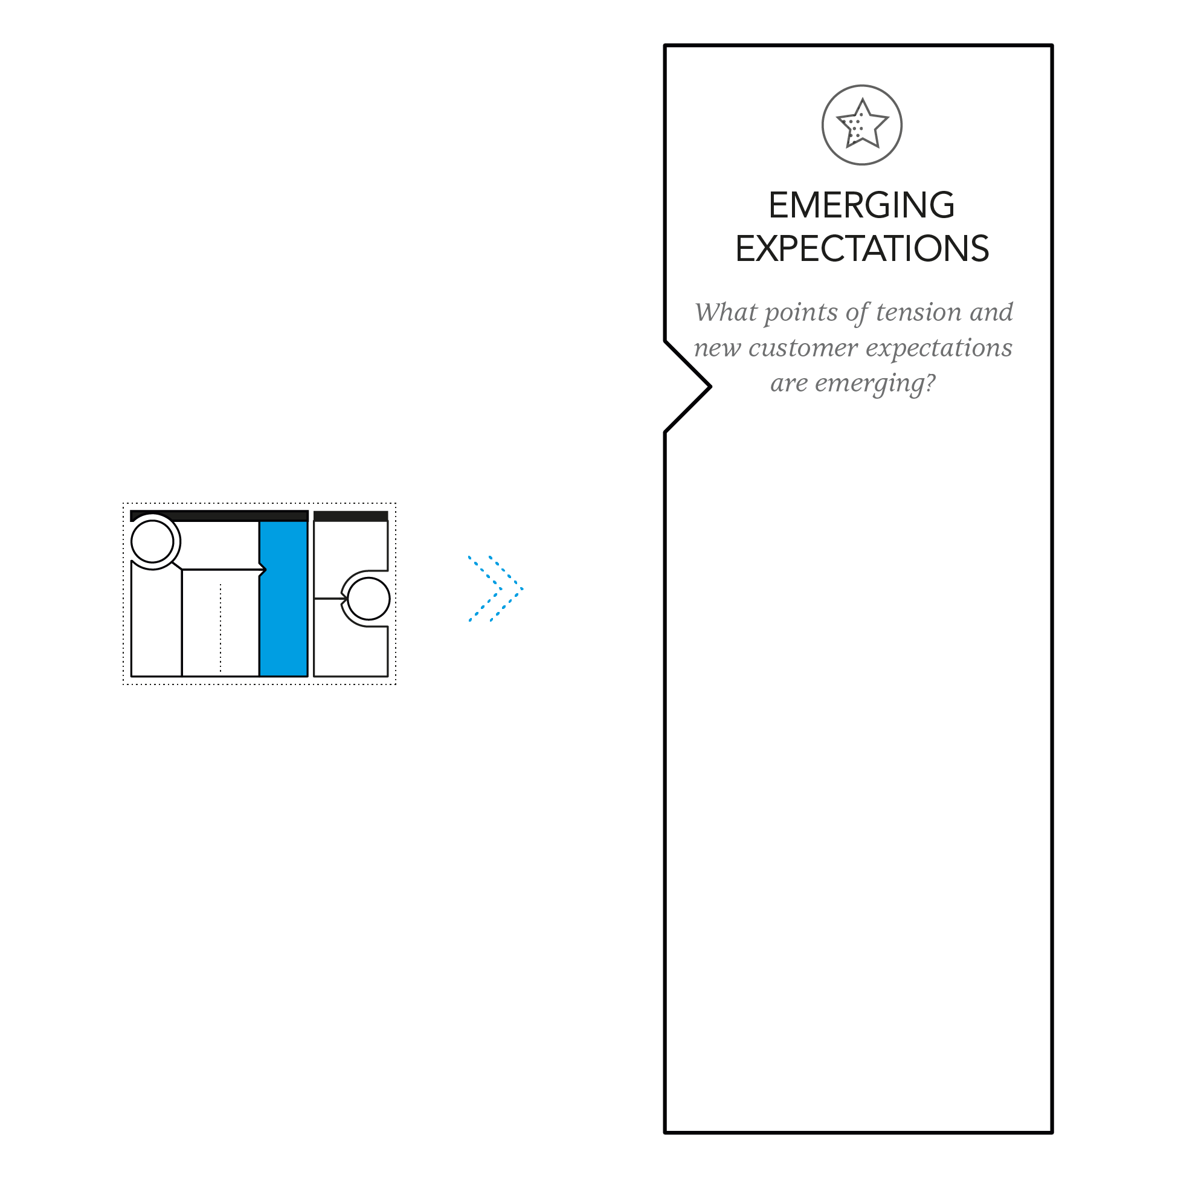
EMERGING EXPECTATIONS
What do consumers now expect from brands that they didn’t before?
NEW ONLINE AVENUES FOR SELF-EXPRESSION
VIRTUAL SPACES THAT ALLOW FOR ESCAPING THE MUNDANITY OF THE IRL WORLD
MORE INTERACTIVE AND EDUCATIONAL CONTENT
VIRTUAL COMMUNITY SPACES WHERE CONSUMERS CAN CONNECT WITH PEERS
Notes:
It’s time to identify how this mega-trend is setting new expectations in the minds of consumers. Having looked closely at our selected innovations, it would be fair to assume that tomorrow’s consumers will expect brands to provide virtual spaces that allow them to escape the mundanity of the IRL world. Consumers will also expect to be offered new avenues for self-expression, and they’ll look favorably upon brands that create virtual community spaces where they can connect with like-minded people. It’s interesting to see how innovations like Pollinator Park are setting new expectations for educational content.
Link: https://www.trendwatching.com/toolbox/consumer-trend-canvas

Slide 73
QUESTIONS TO IDENTIFY EMERGING EXPECTATIONS
This trend creates new desires for...
In light of this trend, people now expect brands to...
Because of this trend, people can’t live without...
Consider the innovations behind this trend.
If you were to interact with them, what would you expect of (other) brands after?
Which events (global social, political, environmental, etc) impacted this trend?
Are there any new technologies powering this trend?

Slide 74
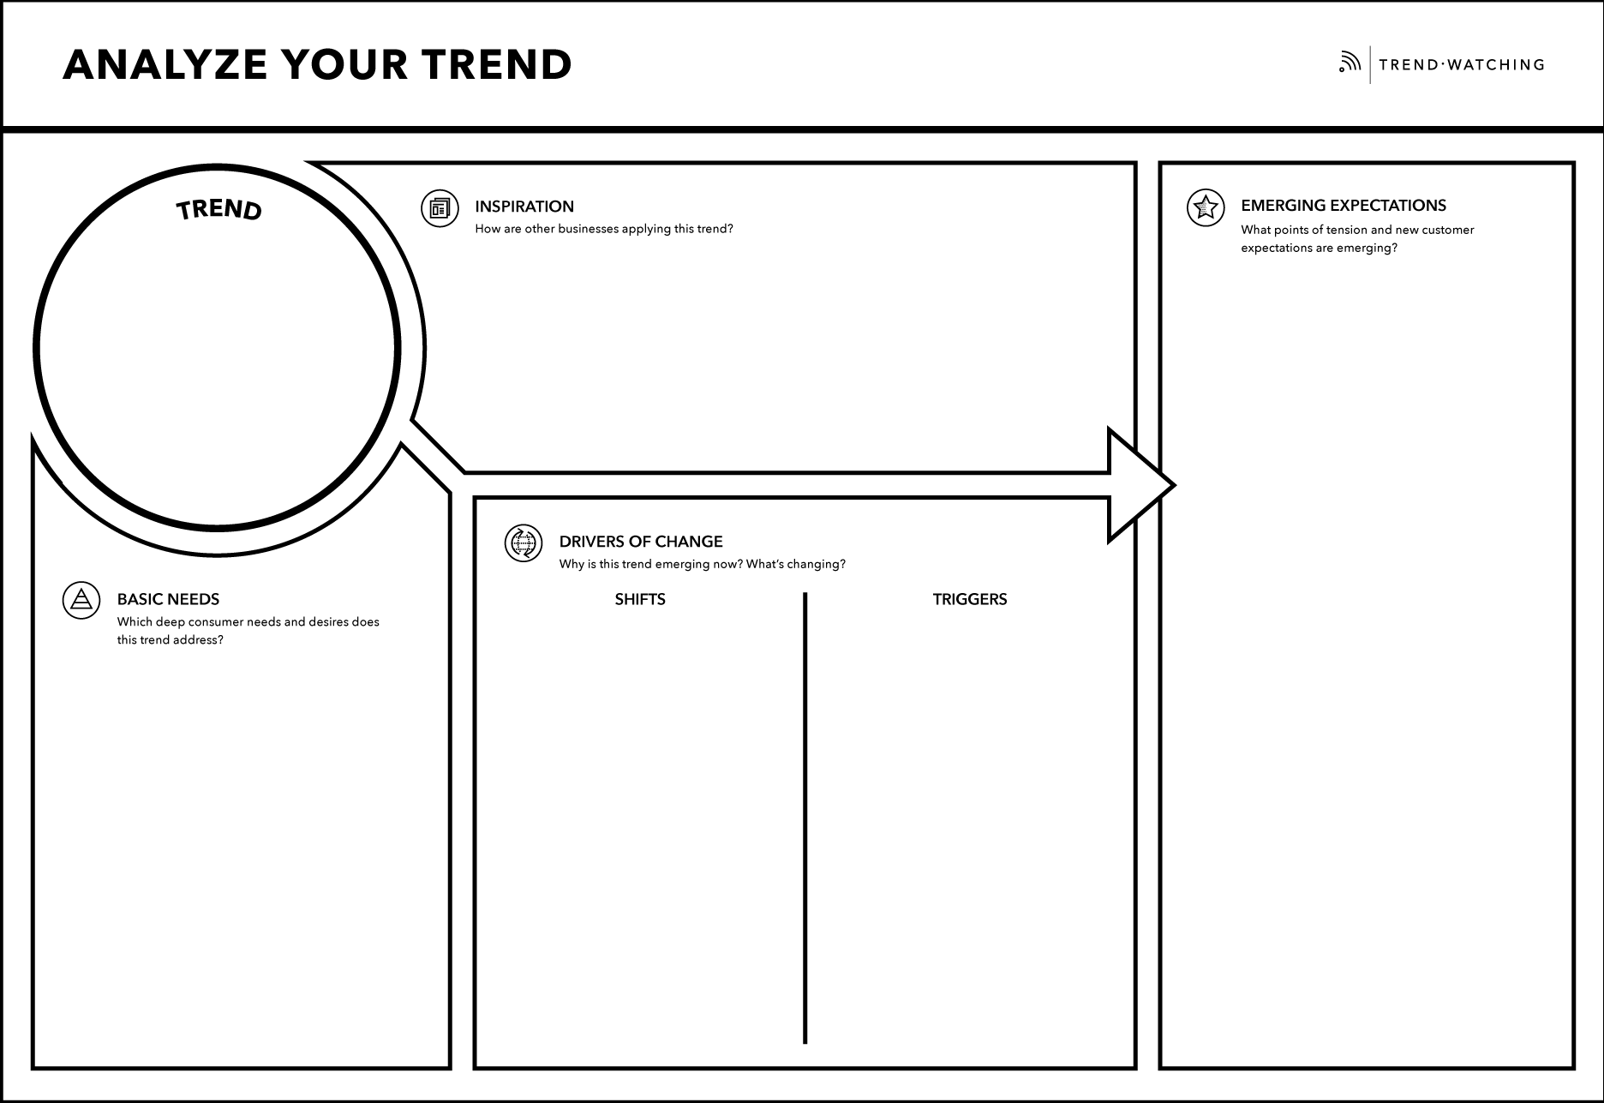
THE FABRICANT STUDIO
CAREER WALES
METAPHYSICAL
ENDEAVORRX
VIRTUAL SPACES THAT ALLOW FOR ESCAPING THE MUNDANITY OF THE IRL WORLD
VIRTUAL COMMUNITY SPACES WHERE CONSUMERS CAN CONNECT WITH PEERS
SELF-EXPRESSION
NEW REALITIES
META GOLDRUSH
NEW ONLINE AVENUES FOR SELF-EXPRESSION
IDENTITY
SOCIAL MEDIA
REMOTE WORK
ENTERTAINMENT
MORE INTERACTIVE AND EDUCATIONAL CONTENT
SOCIAL
STATUS
DECENTRALIZED INTERNET
Notes:
If we would be doing the workshop in person, your canvas would now look something like this.
Link: https://www.trendwatching.com/toolbox/consumer-trend-canvas

Slide 75
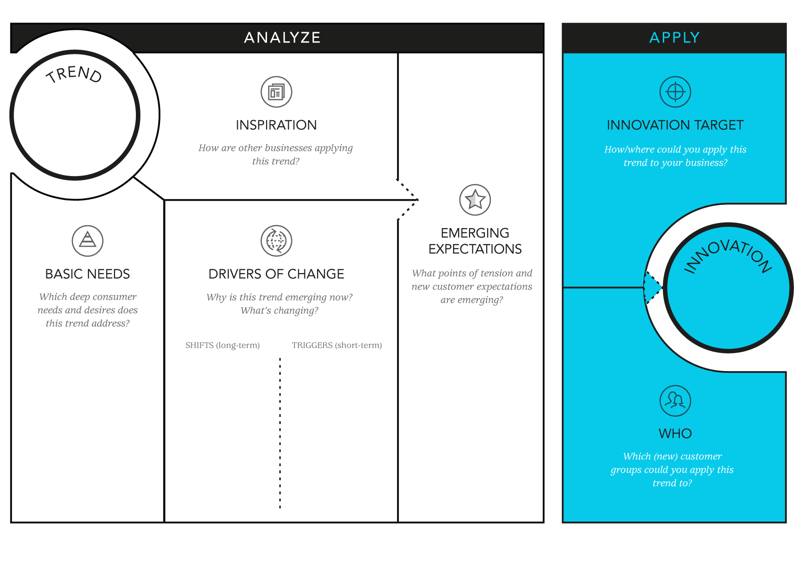
Notes:
Now that we fully grasp what this trend entails and understand its anatomy, we can start identifying its implications by using the apply-section of the canvas.
Link: https://www.trendwatching.com/toolbox/consumer-trend-canvas

Slide 76
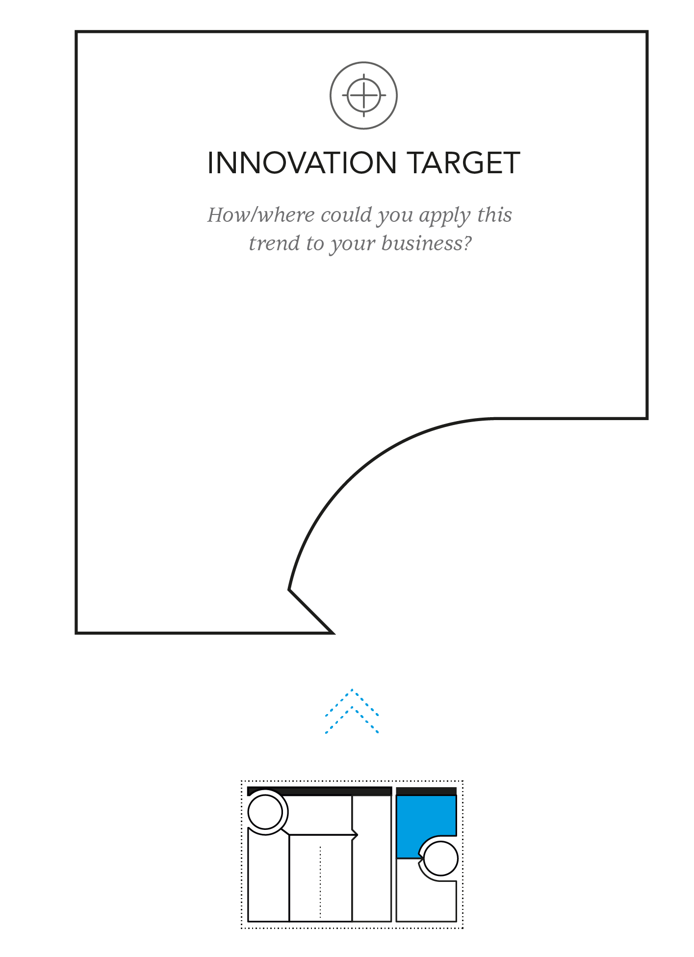
INNOVATION TARGET
How could
you apply
the trend?
A MARKETING CAMPAIGN WHICH USES VR/AR TECH
A SERVICE WITH A PLAYFUL, EXPERI-MENTAL SPIN
Notes:
We’re reaching the end of the canvas – only a couple more steps to go! We like to categorize innovations as services, products, campaigns, experiences or concepts, but the most interesting innovations are those that blur boundaries. Each of the innovations we’ve chosen for this canvas offer a service but with an experiential spin.
Link: https://www.trendwatching.com/toolbox/consumer-trend-canvas

Slide 77
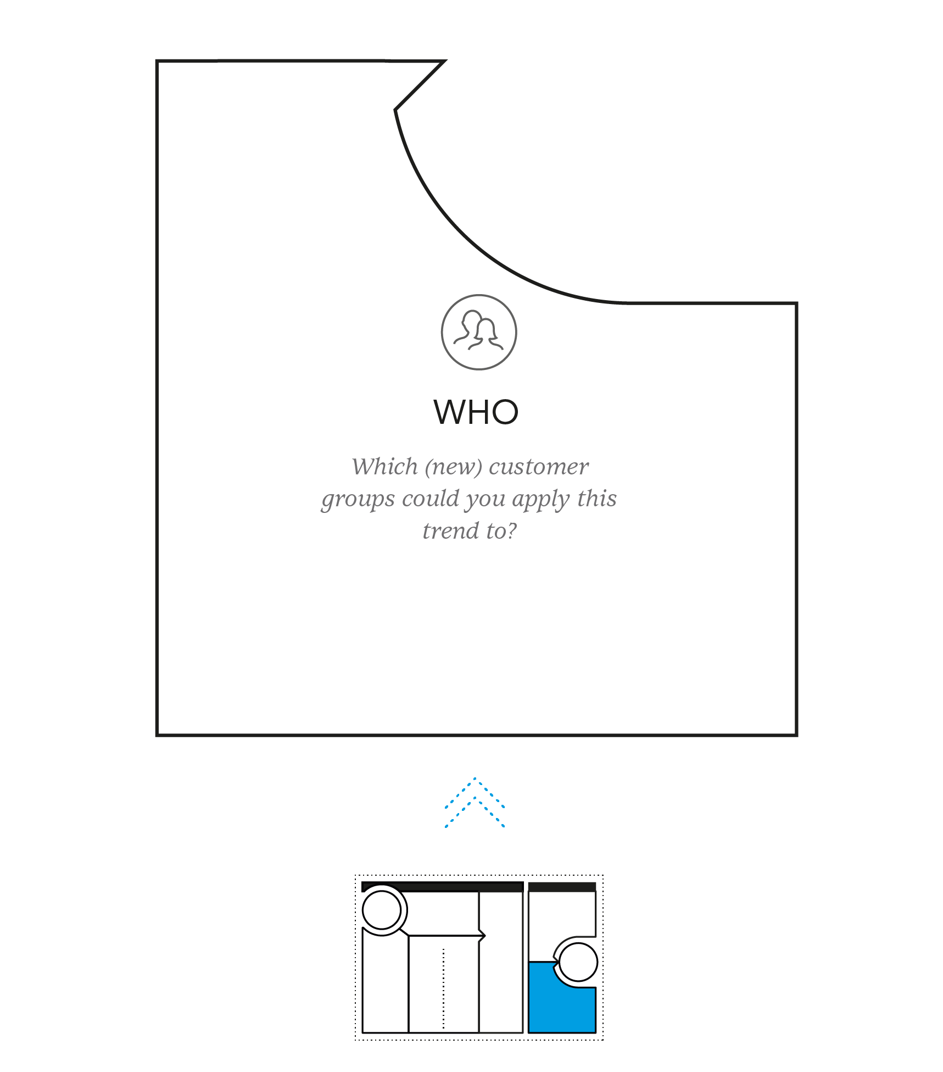
DIGITAL NATIVES
WHO
Who are you innovating for?
GEN ALPHA
Notes:
Who is your innovation for? You will have the best knowledge for this. Are there specific generational groups, regions, or niches that would benefit from your innovation? Don’t feel restricted by your brand’s current target audience. We decided to focus on digital natives – who surveys have found are the most open and willing to test out metaverse-style activations.
Link: https://www.trendwatching.com/toolbox/consumer-trend-canvas

Slide 78
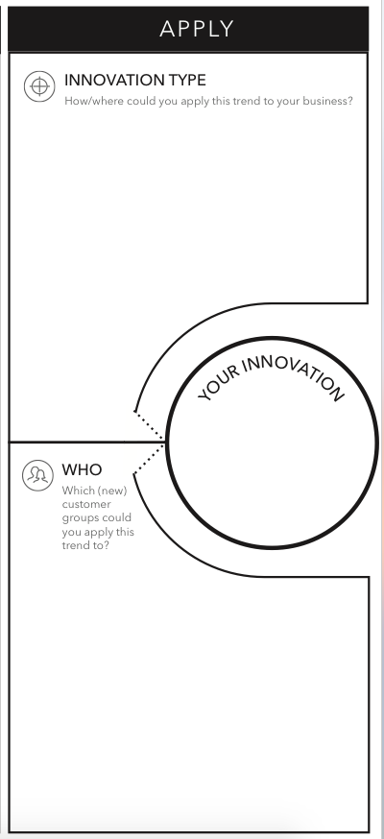
A SERVICE WITH A PLAYFUL, EXPERI-MENTAL SPIN
A MARKETING CAMPAIGN WHICH USES VR/AR TECH
YOUR INNOVATION!
GEO SNAPS
DIGITAL NATIVES
GEN ALPHA
Notes:
You’ve made it! Time to collate all the information you’ve gathered so far and come up with a new innovation of your own. Our creation? A Snapchat-based geo-tagging game which invites players to discover sustainable stores, attractions, and restaurants in their locality. Once users have visited 10 places, they’ll be rewarded with a virtual token which can be redeemed at any of the participating retailers or restaurants.
Link: https://www.trendwatching.com/toolbox/consumer-trend-canvas

Slide 79
Over to you!
Feel free to reach out: erick@trendwatching.com
Notes:
I've said this at the beginning, and I will repeat it again now. Trends are only valuable once you start acting on them, and the same rings true for the opportunities we provided throughout this webinar. We played our part and the innovators we mentioned did their due diligence as well, so now it's up to you to start running with the toolbox we provided.
To do so, the one thing I would like to ask of you, is to take one of the trends presented, make it your own and explore what opportunities it holds for your business specifically. Please find your own canvas at: https://www.trendwatching.com/toolbox-consumer-trend-canvas
This Canvas is available to you indefinitely, and if you send me your filled out canvas, I will personally see to it that you receive feedback from either myself or someone else from our amazing Content team.

Slide 80
Notes:
Before we let you go, we’d like to spotlight some of the Premium and Custom services that we’re currently offering to over 1100 clients in 35+ countries.

Slide 81
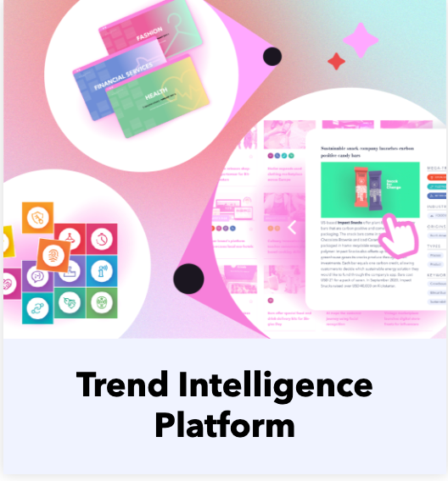
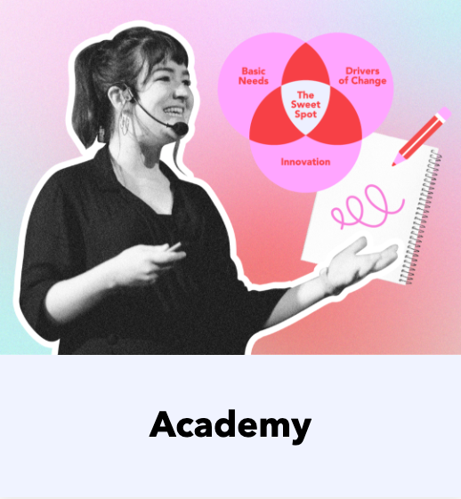

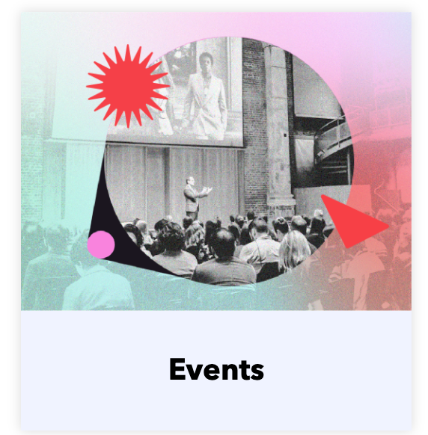
Our Services
From trend intelligence to training: we have you covered.

Slide 82
A world-class, yet affordable trend intelligence platform
Giving you access to our full Trend Framework, Innovation Database with 26,000+ innovations, 2022 Trend Report, Industry Reports, Ask an Analyst service and more.
Everything you need to guide and inspire you to turn trends into meaningful innovations.
Notes:
Link: https://www.trendwatching.com/premium

Slide 83
Our 25-lesson, self-paced online video course
Access 10+ years of working with consumer trends into a new curriculum – now used by 400+ brands, agencies and universities worldwide.
Designed to train you in forecasting and applying, developed using our methodology and taken at your own pace.
You can subscribe now and enjoy a limited time offer of 22% off, using the coupon code ACADEMY22. Valid until 8 February 2022.
Notes:
Link: https://www.trendwatching.com/academy

Slide 84
Personalized guidance, research and content from our Trend Analysts
Our team of Trend Analysts & Presenters have delivered literally 100s of keynotes, workshops and customized reports, in 35+ countries, to some of the world's leading brands and agencies.
We know how to deliver.
Notes:
Link: https://www.trendwatching.com/bespoke

Slide 85
Our public Trend Events and Workshops, from Boston to Bangkok
Join us around the world, both online and offline, for highly curated events - we'll announce new dates very soon. Make sure you're subscribed to our free trend updates to be among the first ones to find out where and when next.
Notes:
Link: https://www.trendwatching.com/subscribe

Slide 86

Ready to act on
consumer trends today?
Then reach out to Matthijs van Waveren, our Business Development Director. Your message will go straight into his inbox and will be replied to asap.
Matthijs van Waveren
Business Development Director
workwithus@trendwatching.com

Slide 87
Notes:
That is all that we have for you today. We hope you found this webinar and its guiding slide deck to be insightful, inspiring, but above all, I hope that we have triggered you to take purpose-driven action! We’re looking forward to seeing all of your amazing canvases come our way soon, good luck! Bye for now, can't wait till we meet again.

